Slide 1
N.C.S.A BUSINESS MEETING/
AWARDS DINNER - 2016

Slide 2
Member Achievements and Milestones in 2016
Numbers
Awards and Recognition

Slide 3
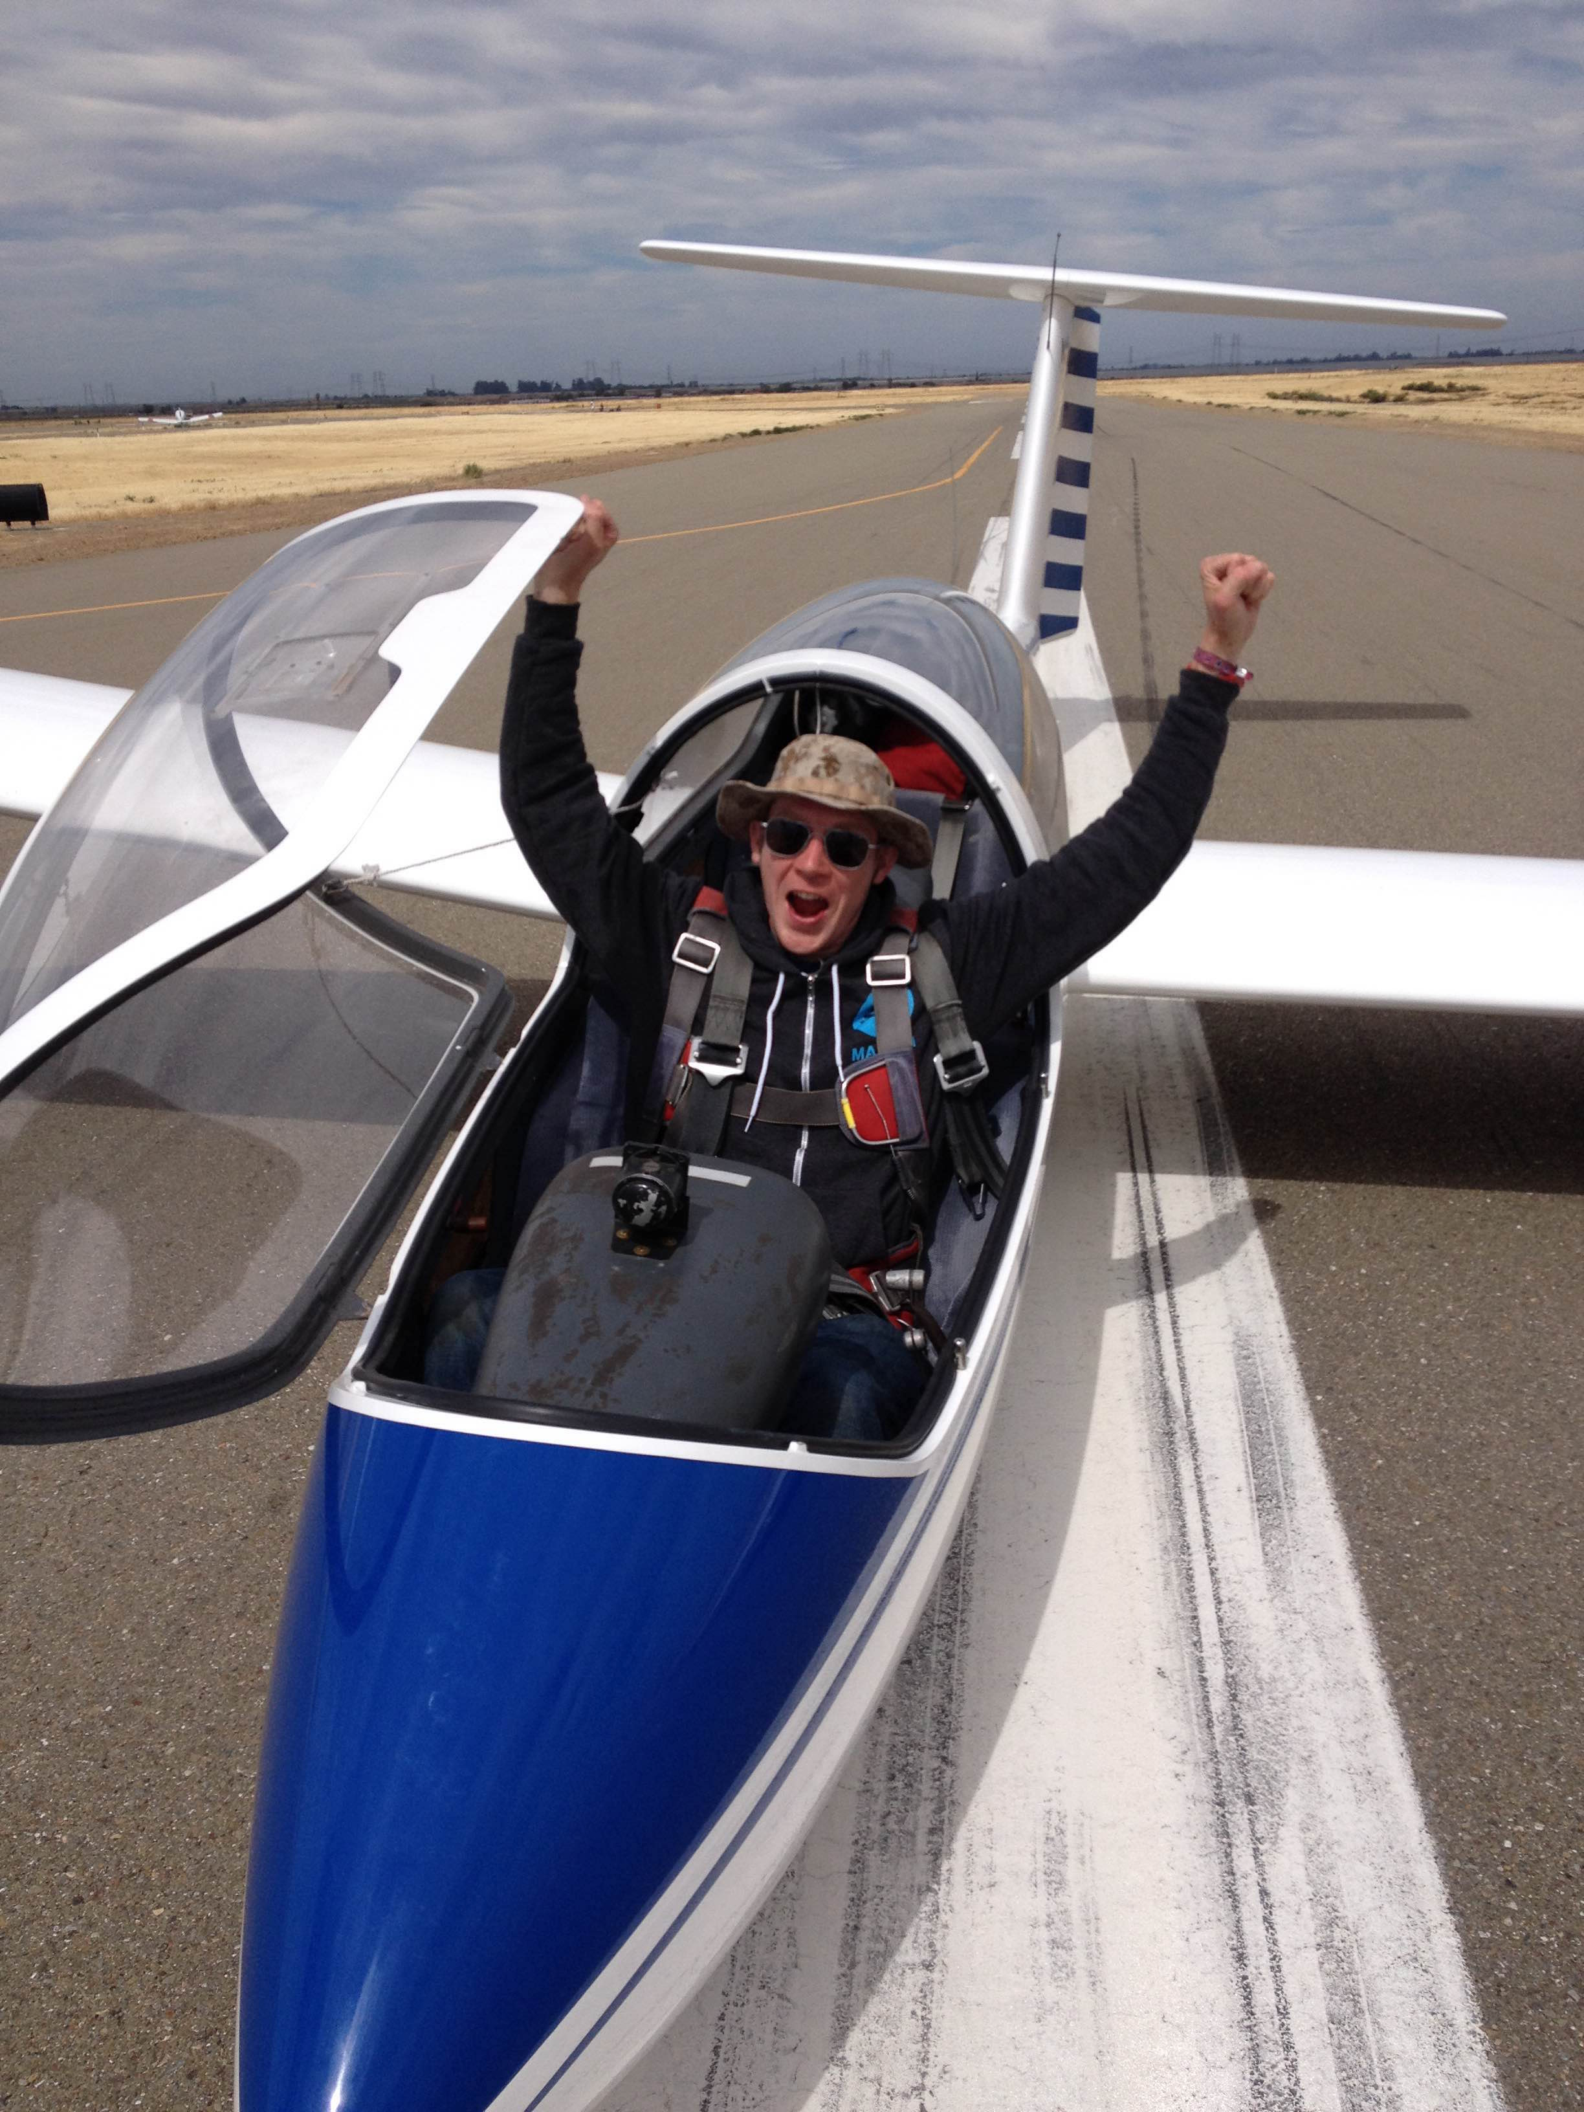
FIRST SOLO in 2015
Tobin Fricke

Slide 4
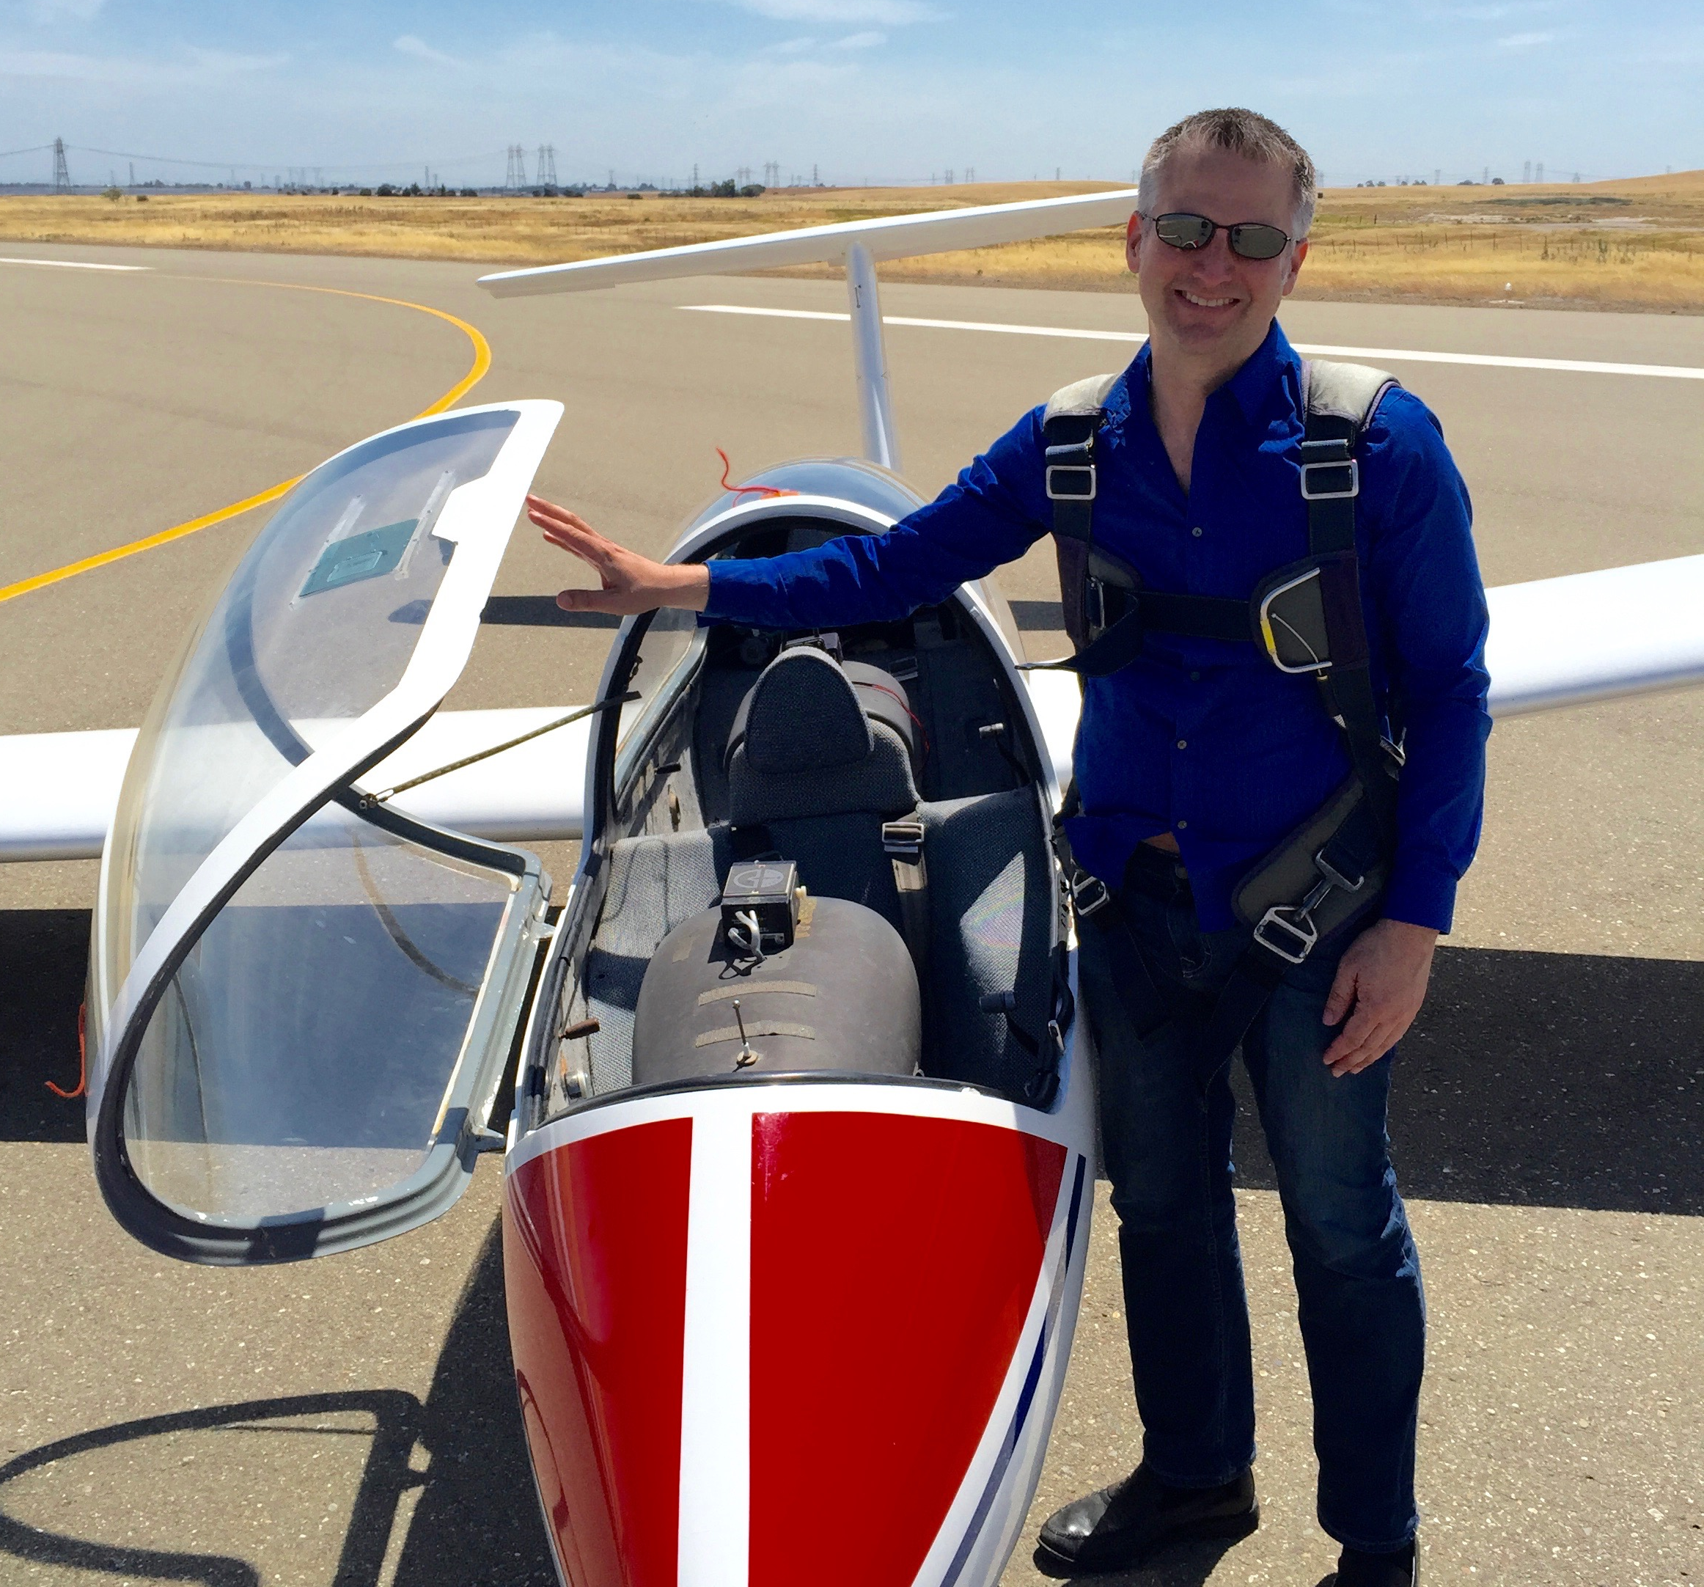
FIRST SOLO in 2015
Mark Rogers
(ok, he 1st soloed ~30 years ago….)

Slide 5
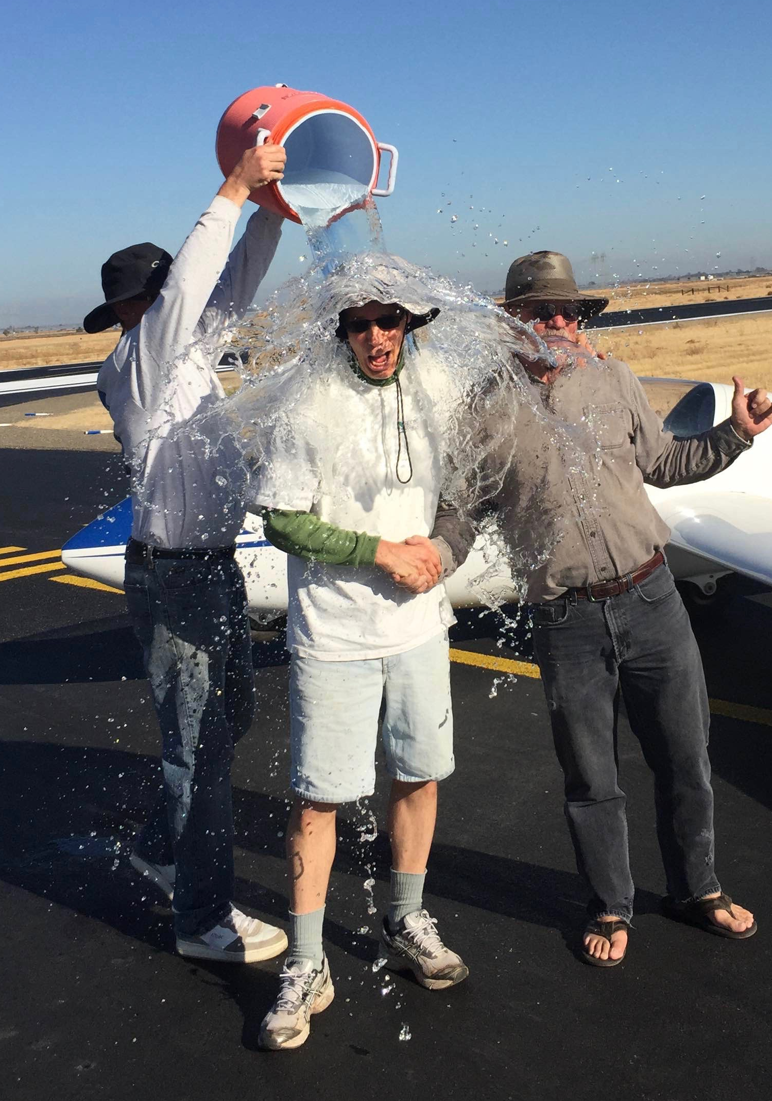
FIRST SOLO in 2015
Todd Denman
(also a re-solo from decades ago)

Slide 6
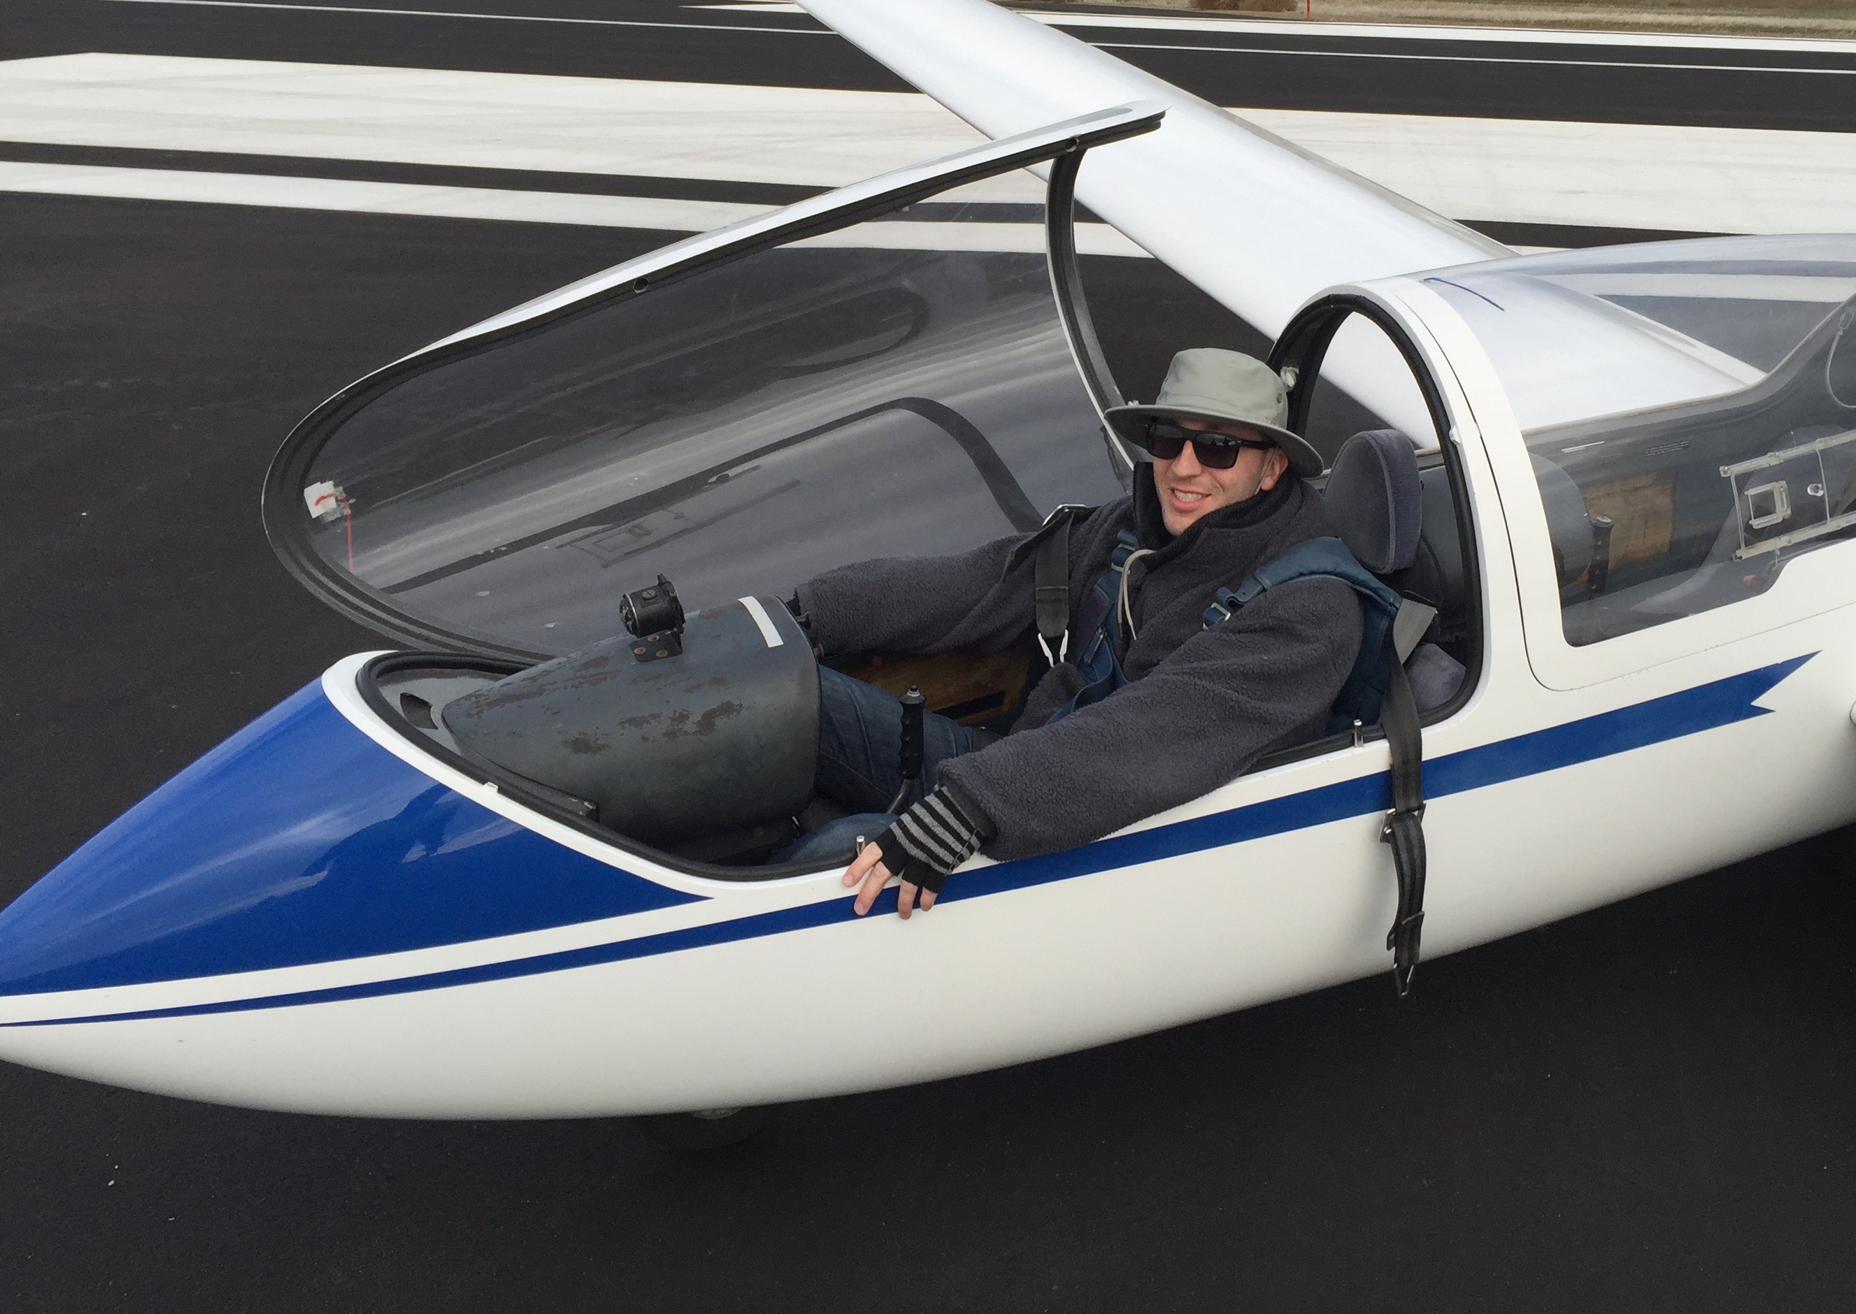
FIRST SOLO in 2015
Ace Lewis

Slide 7
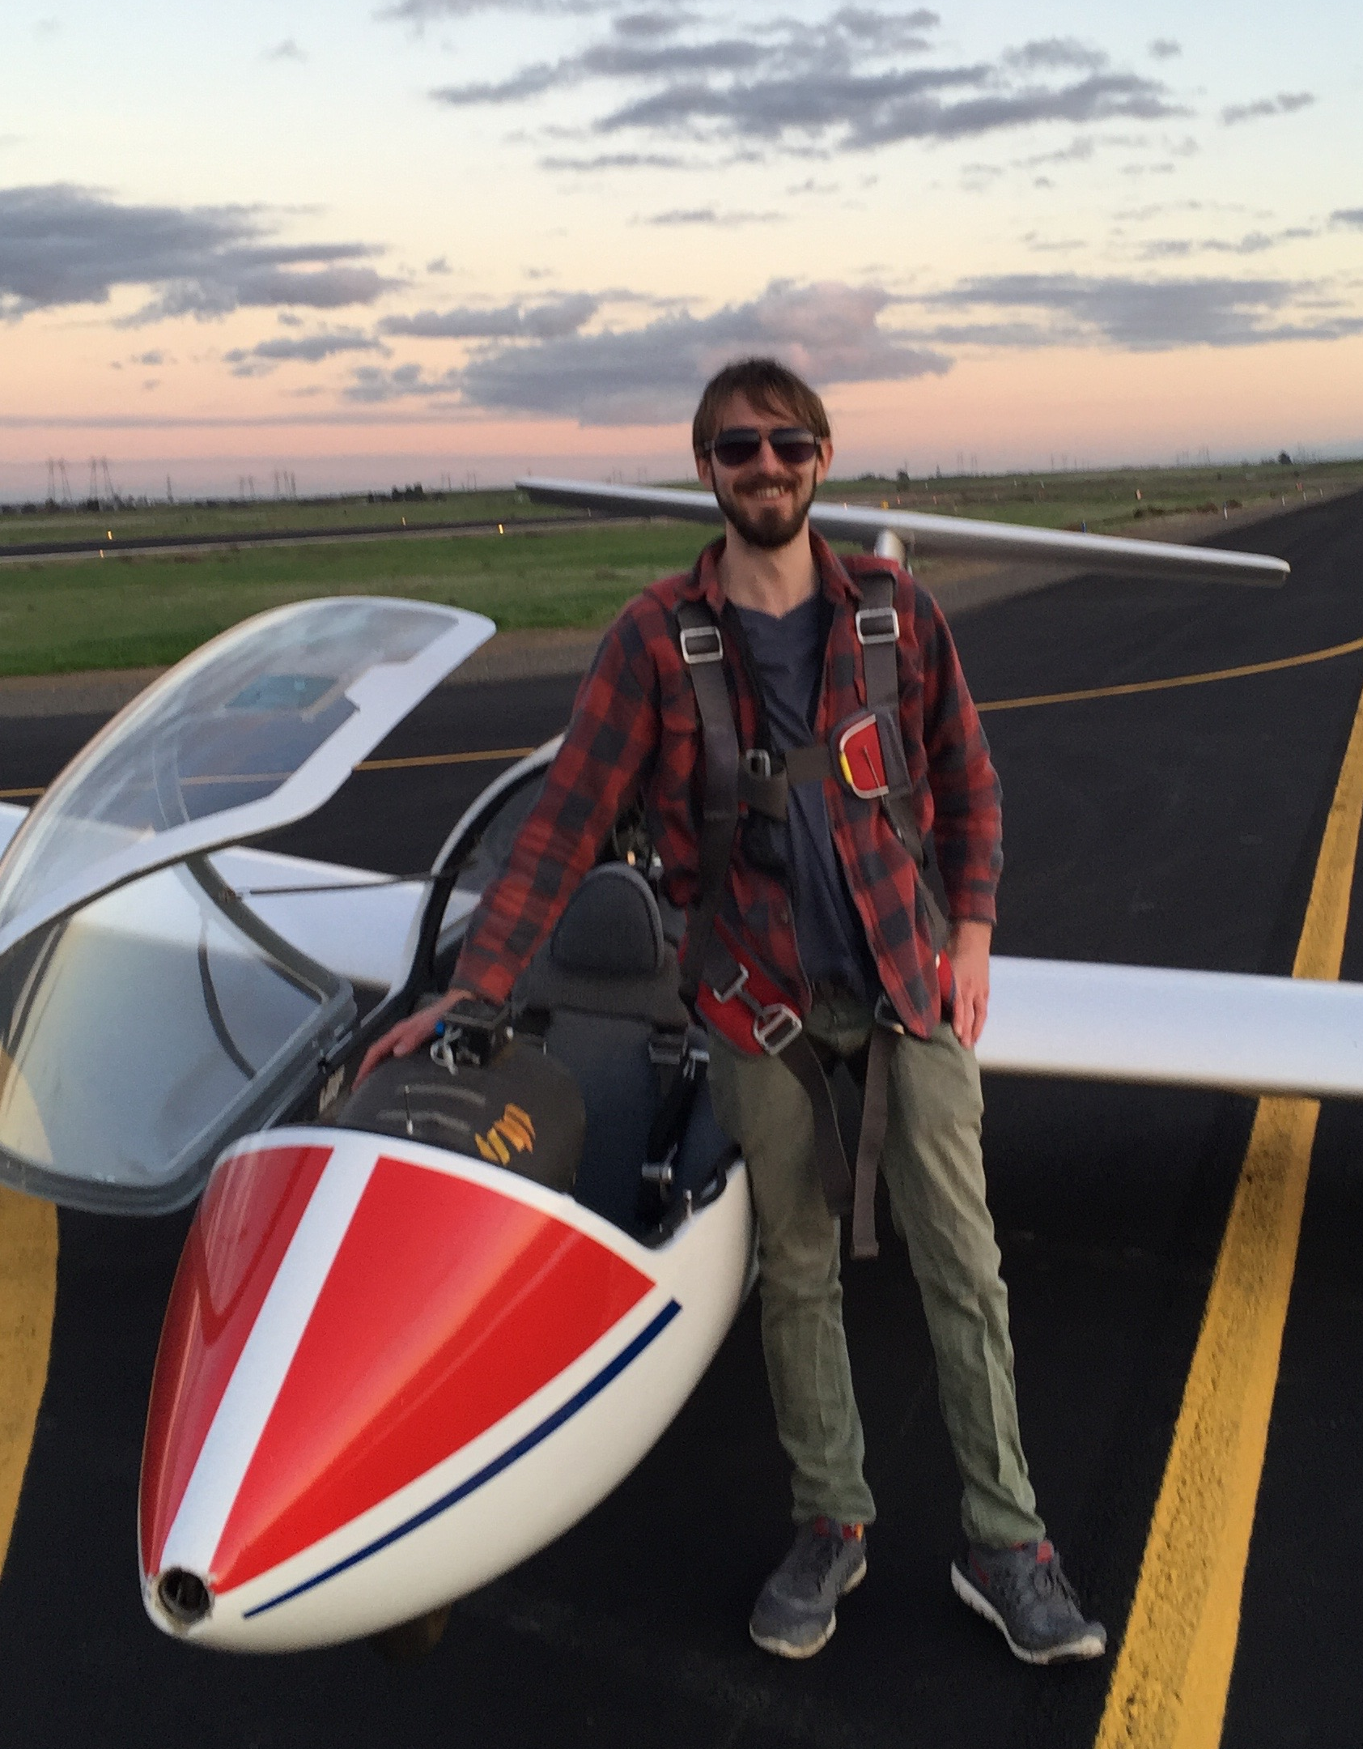
FIRST SOLO in 2015
Simon Vana

Slide 8
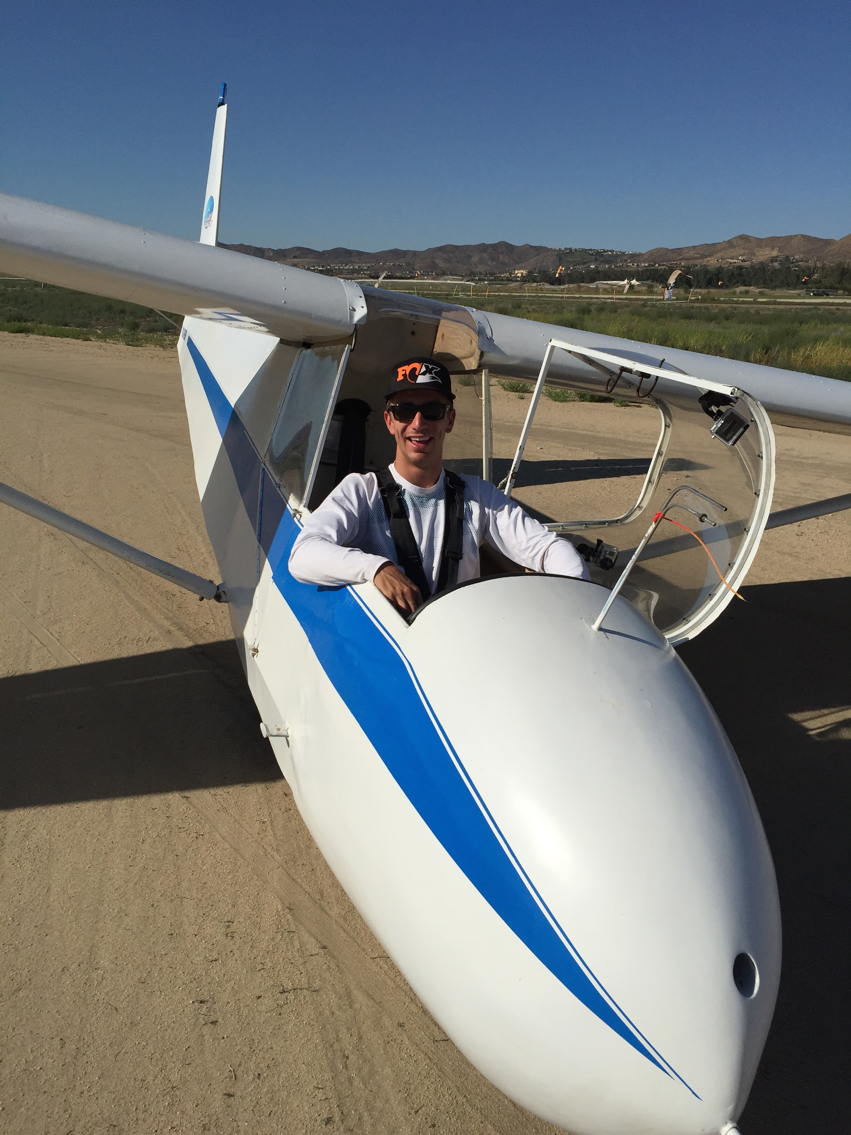
FIRST SOLO in 2015
Brent Davidson
(soloed at Lake Elsinore in October before moving to the Bay Area)

Slide 9
New Glider Ratings or Wings
Matthew Gast- CFI-G
Aki Kaniel- Private Pilot
Marton Kun Szabo- Private Pilot
Mark Rogers- Commercial Pilot
Chandler Lougee- Private Pilot

Slide 10
Chandler writes
Though I will not be able to make it to this year's Annual Dinner as I am in school in Seattle I would like to extend my thanks to the entire club for helping me finally achieve getting my license. I would not have been able to any of it without the support of everyone, especially the instructors like you and Terence and the tow pilots. Please, if possible, extend my gratitude to everyone there.

Slide 11
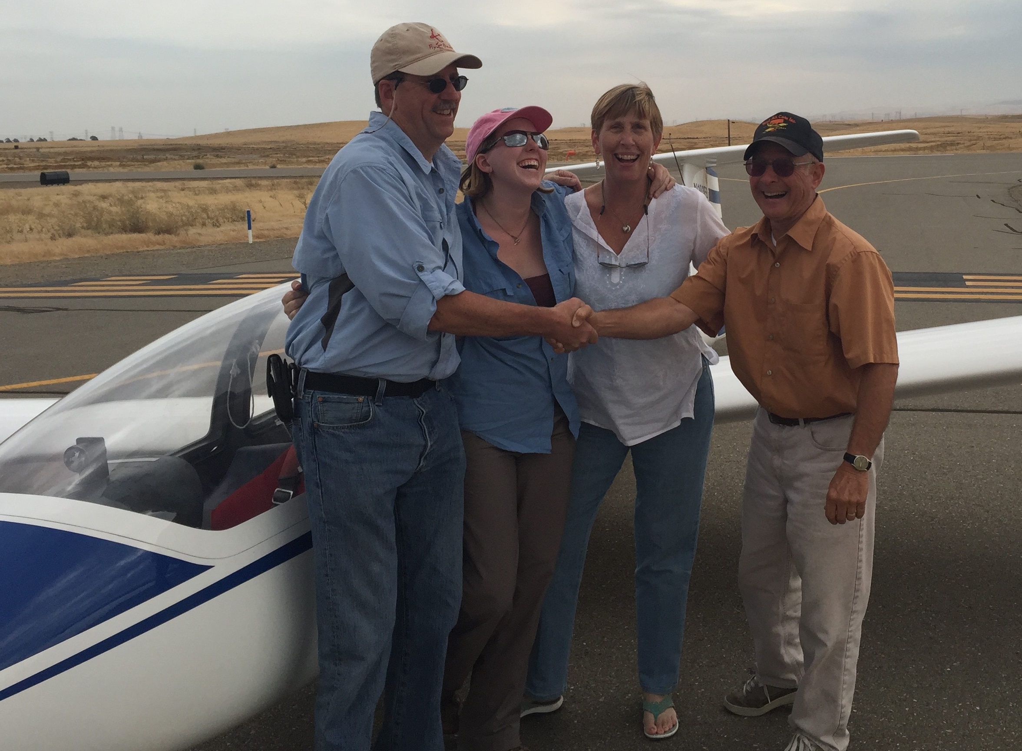

Slide 12
CHECK-OUTS IN NEW GLIDERS
Tobin Fricke- Grob 103
Mark Rogers- Grob 103, SGS 1-26
Todd Denman- Grob 103
Aki Kaniel- Grob 102, KP
Marton Kun Szabo- L-33, SGS 1-36, Grob 102, KP
Ace Lewis- Grob 103, SGS 1-26
Willy Snow- DG-300

Slide 13
CHECK-OUTS IN NEW GLIDERS
Tom Anklam- L-33, L-23
Simon Vana- Grob 103
Larry Suter- SGS 2-32
Matthew Gast- SGS 2-32
Van Henson- SGS 2-32
Brent Davidson- SGS 2-33

Slide 14
BADGES & BADGE LEGS
Dan Colton- Silver Badge #6982
Willy Snow- Silver and Gold Duration (first 10 years ago was nullified by a problem with the recorder) Silver Badge and Gold Altitude
Marton Kun Szabo- Silver duration and altitude at ASI

Slide 15
Camps
Maja Djurisic- Co-organizer of WSPA in Minden
Marianne Guerin- WSPA Minden
Buzz Graves- WSPA Minden
Dale Roberts- WSPA Minden
Andrew Chant- XC Camp
Buzz Graves- 11th year as lead pilot at XC Camp

Slide 16
Camps (continued)
Tom Anklam- Thermal Camp
Marton Kun Szabo- Thermal Camp
Aki Kaniel- Thermal Camp
John Scott- Assistant Director and Chief Tow Pilot at Thermal Camp
Larry Suter- Director of Thermal Camp
Marianne Guerin- Bishop Encampment
Larry Suter- Bishop Encampment

Slide 17
FLIGHTS AT NEW GLIDER SITES
Aki Kaniel- Air Sailing, KMEV, KTRK
Dan Colton- Hollister, Tracy and Panoche
Dale Roberts- Minden, Omarama, Hollister (tow pilot)
Marton Kun Szabo- Air Sailing

Slide 18
FLIGHTS AT NEW GLIDER SITES (page 2)
Willy Snow- Susanville (land then TO), Panoche, Hollister
Tom Anklam- Air Sailing
Marianne Guerin- Hollister, Truckee, Bishop

Slide 19
BESTS/MEMORABLE in 2015
Aki Kaniel- 3 hour flights in the Sierras to altitude of up to of 15,000
Ace Lewis- I started receiving instruction in October this year, and really got hooked.
Paul MacDonald- I mostly enjoyed sorties with my family. As you know, my older son Ryan got an introduction to soaring at NCSA in the Spring. He then went on to his First Solo at the Air Force Academy during the Summer.

Slide 20
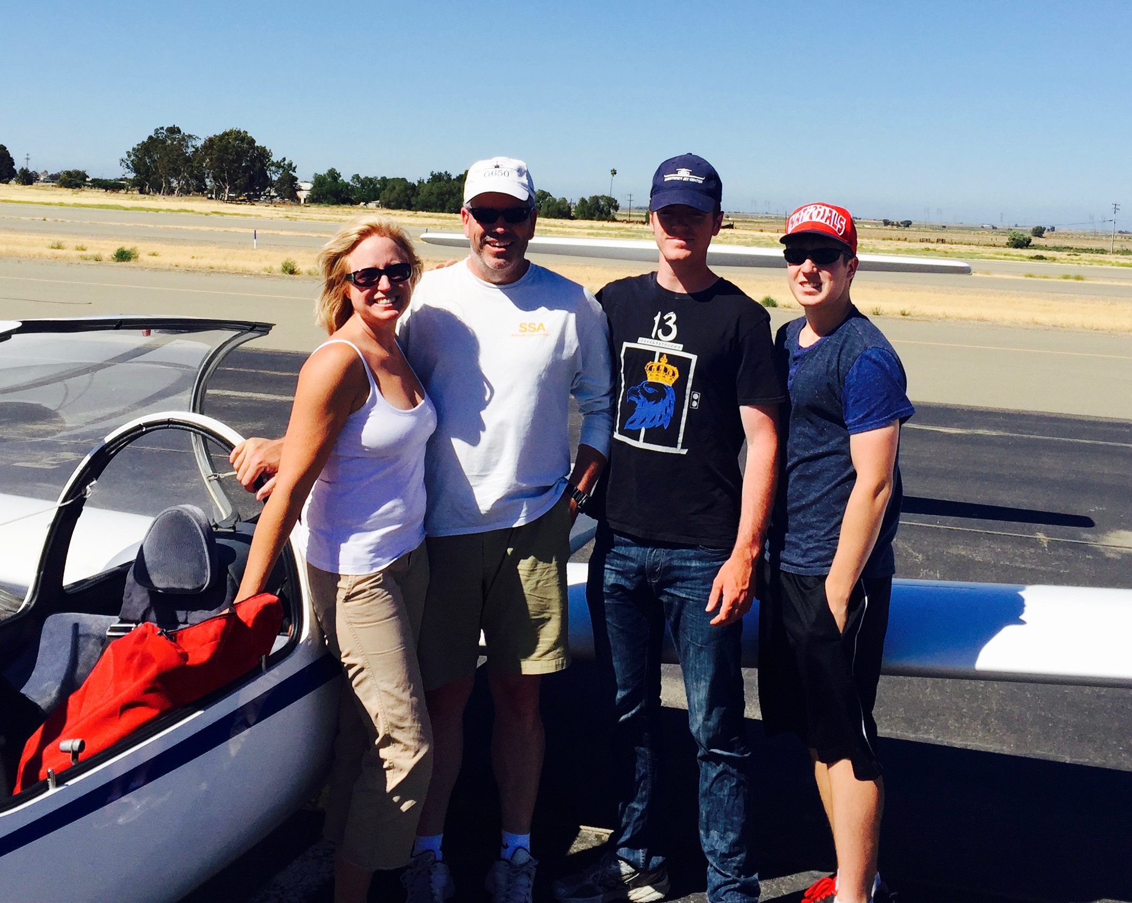

Slide 21
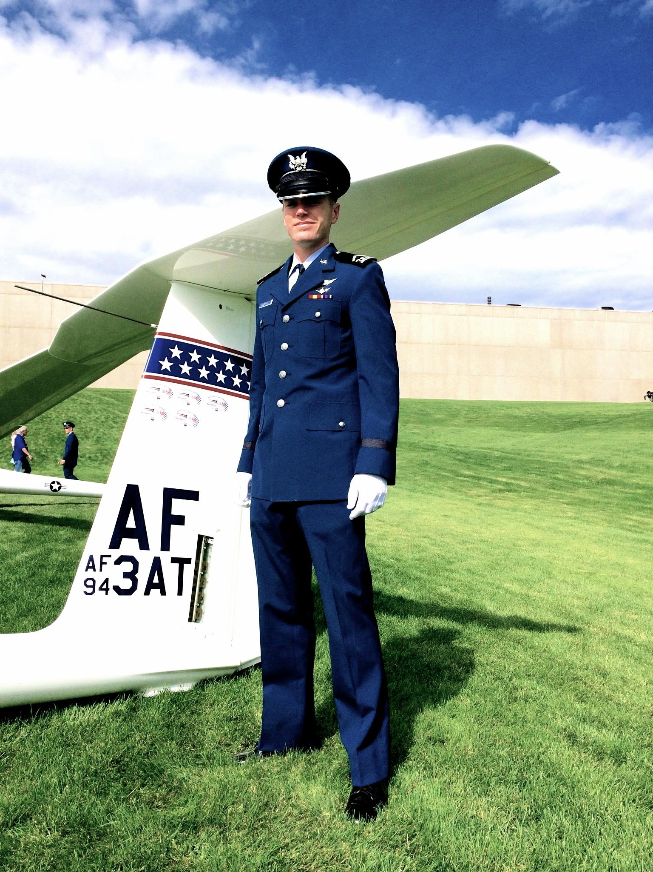

Slide 22
BESTS/MEMORABLE in 2015
Dale Roberts- All my glider flights last year were dual flights. Most of them were with guys who were not CFIGs (like Ed Lord and Harry Fox) so these flights were not loggable. I keep a record of most of these flights like this in the back of my logbook and I flew roughly 26 hrs. The highest flight was to around 20,000 ft. out of Omarama (they don’t have that pesky 18K rule in NZ).

Slide 23
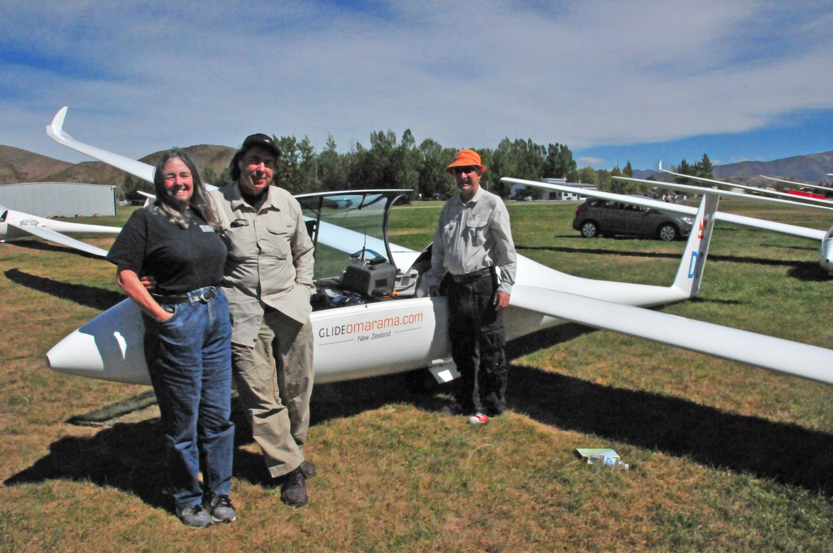

Slide 24
BESTS/MEMORABLE in 2015
Tom Anklam- ~4 hours aloft at Air Sailing, >14,000 ft at Air Sailing.
Best of the year was a weekday flight last spring. John Scott stepped up to tow on short notice. Van joined me in playing hooky from our jobs at the Lab. We hit on a perfect day with 6000 ft ceiling and lift pretty much everywhere. We more or less had the sky to ourselves for over 3 hours of effortless local soaring. Landed at sunset to a sky filled with spectacular lenticular clouds. Put the plane away, drove back to the Lab, and finished the paper that I was writing. Home for dinner by 8.

Slide 25
BESTS/MEMORABLE in 2015
Willy Snow (in his new DG-300)- I flew two 300+ K flights and several 250K flights. My farthest south was Sweetwarter and farthest north was to the north east of Susanville.
When I jointed the Region 11 contest I had never flown 300k.
My first Region 11 practice flight of the year was 330K from Truckee to North of Susanville to Air Sailing, to Reno Stead and Return.
For someone not having pushed myself for a few years it was a great confidence builder for the rest of the contest.

Slide 26
BESTS/MEMORABLE in 2015
Marianne Guerin- My first (and to date best) XC flight out of Hollister was Hollister- Black Mtn- Hollister. It arose from a challenge from Eric Rupp and I DID IT, including digging out of an infamous hole near Panoche on the return. ~280 km as the crow flies.
Couple of nice flights during the WSPA seminar in Minden, including a nice wave flight on a questionable day nearly to over 17 K.
Dug out of VERY low point near Nervino and made it all the way back to Stead - four hours of battle on an “interesting” east wind day.

Slide 27
BESTS/MEMORABLE in 2015
Todd Denman-
First glider ride in decades. First mountain flight and first flight to 12k and first flight at Truckee, all rolled into one, a very inspiring experience - with Larry. First time w/ oxygen - w/ Buzz at Truckee above 12k. my flight number 13 and first time w/ Buzz was intended to be a short flight but we encountered convergence and thermals and it turned into a 3-hour flight over Byron in June, during which I learned a vast amount while thermaling and chasing birds and S-turning through broken convergence, and after that everything felt different than before, it was a breakthrough flight. First long wave flight was an amazing 3-hour plus flight with John Boyce in August which was forced to end only because of sunset; with thanks to Paul for towing us towards a scary looking cloud downwind of the forebay, another breakthrough flight.I also had a notable 1.5-hour wave flight over the reservoir with Buzz in Kilo Pappa, during Oktoberfest, the first time sharing close air space with other gliders, and flying above a broken blanket of clouds in wave over water was amazing, and again forced to land because of sunset. During both wave flights, descending in abendrot and twilight through the shadow of Mount Diablo and gyrating the glider in all kinds of ways to lose altitude and touching the runway at sunset was memorable. Climax of the year was my first solo - on Halloween, thanks to Buzz, directly after I made a spectacularly failed attempt at landing without spoilers by sailing high over the ground crew in full side slip and getting way off course from the runway until I was directly over the taxiway instead. Buzz remained silent in the back seat allowing me to make my own mistakes, and somehow I managed to land decently back on the runway and even take the second turnoff. I knew I was in trouble when Buzz and Matthew stepped aside and conferred. And befitting Halloween thanks to Marianne and others on the ground, they tricked me into posing for a photo with Buzz and dunked me from behind with a pumpkin colored water cooler. Huge thanks to all the instructors with whom I’ve learned so much, and tow pilots and club members who’ve been so generous with their time, wisdom and humour.

Slide 28
BESTS/MEMORABLE in 2015
Todd Denman-
First glider ride in decades.
First mountain flight at Truckee
Flight #13 w/ Buzz turned into a 3-hour flight over Byron in June
an amazing 3-hour plus wave flight with John Boyce in August which ended because of sunset;
1.5-hour wave flight over the reservoir with Buzz in KP, during Oktoberfest,
My first solo - on Halloween
The post solo photo
Huge thanks to all the instructors… tow pilots and club members who’ve been so generous with their time, wisdom and humour.

Slide 29
BESTS/MEMORABLE in 2015
Ramy Yanetz-
Looking back at 2015 - it was my best soaring year!
More flights, hours, distance and speed than ever before
My longest flight ever (1792km/1113 miles), in a yoyo wave flight from Minden at an average speed of 183 kmh.
Crossed California and the Sierra from the Pacific to Carson City and back to Stockton

Slide 30
BESTS/MEMORABLE in 2015
Dan Colton- I had my best flying year ever in 2015
XC flight of 219 km from Truckee.
Flew one flight in Hollister League (295 km XC mentoring flight with Kurt Thames in BASA DG505).
Flew 81C in Panoche Glider Palooza and got to experience "The Convergence", Larry's Bar & Grill, and Mercey Hot Springs
XC Mentoring flights with Larry and Buzz up at Truckee including the longest XC flight that 81C made all year (196 km out of Truckee)
Achieved NCSA XC endorsement for club gliders
Received PASCO award for longest Region 11 Silver distance flight

Slide 31
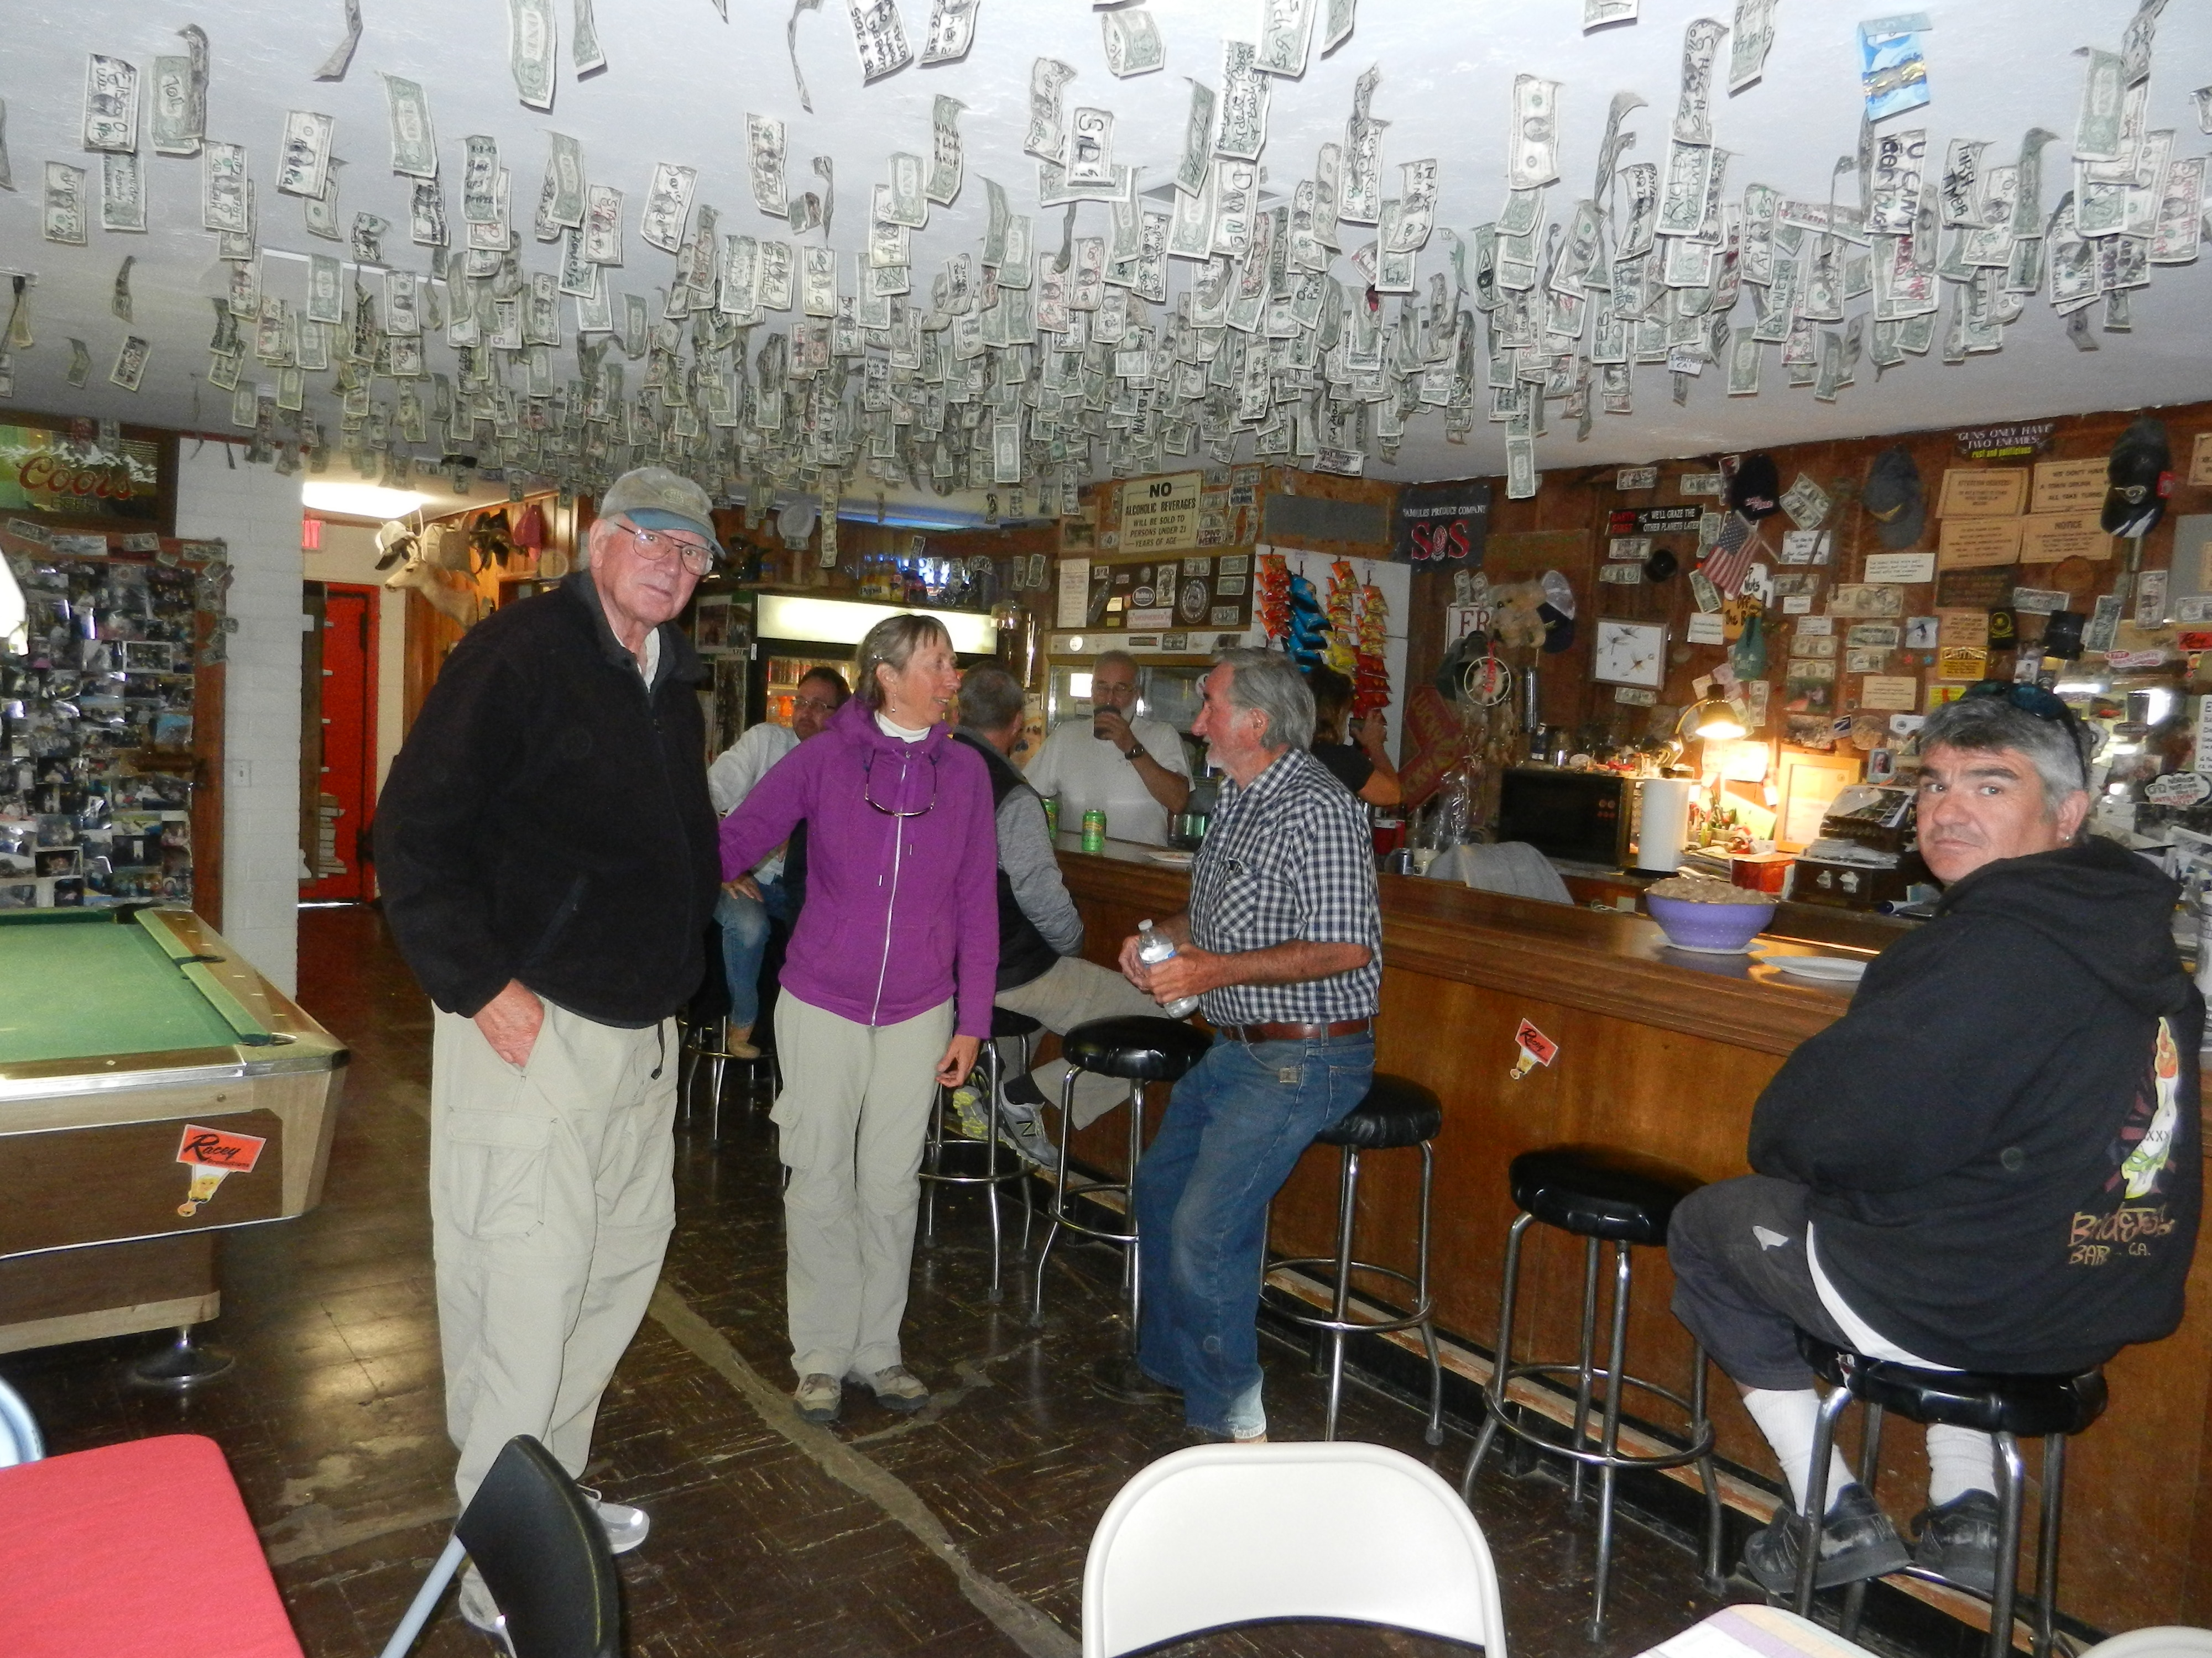

Slide 32
BESTS/MEMORABLE in 2015
Larry Suter-
Best year soaring ever- Flew more, flew further and moved my comfort zone.
ASI- near Bridgeport-7990-ASI was a thrill.

Slide 33
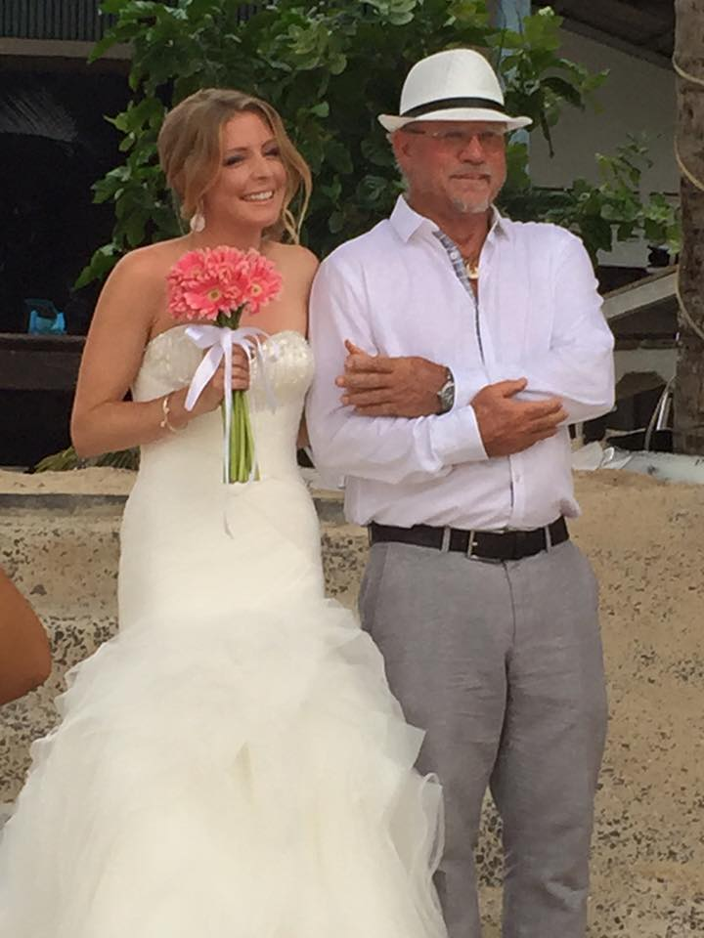
BESTS/MEMORABLE in 2015
Wait a minute….. What about Buzz?
Buzz’ most memorable moment was his daughter’s wedding last summer in Thailand
But he still managed to fit in 13000+ km

Slide 34
Goals for 2016
Dan Colton- ASI XC camp and complete requirements for Gold Badge with 300 km XC flight
Marton Kun Szabo- XC Camp, Silver distance
Tom Anklam- First Cross Country
Ace Lewis- Private rating, learning to efficiently find and utilize lift. Maybe A & B badges
Todd Denman- Learn to land the glider on the runway with a slip.

Slide 35
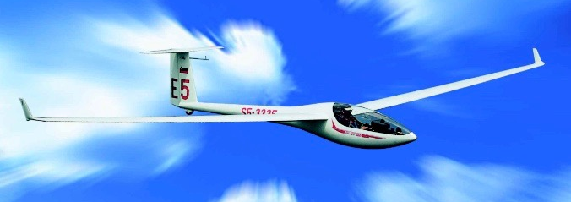
Goals for 2016
Willy Snow- 2016 Goal is to complete my official “pre-declared” Gold 300K Distance and Diamond Goal which is a 300K Triangle
And maybe spruce-up his DG-300 with winglets

Slide 36
Goals for 2016
Ramy Yanetz- “Flying more, maybe?”
Larry Suter- Same as Ramy
And, maybe, the same as Willy

Slide 37
Member Achievements and Milestones in 2015
Numbers
Awards and Recognition

Slide 38
TOTAL GLIDER CROSS-2015 OLC COUNTRY KM
Maja Djurisic 306
Andrew Chant 434
Tom Anklam 588
Walter Friedrich 754
Brian Roach 792
Marton Kun Szabo 881
Morteza Ansari 1070

Slide 39
TOTAL GLIDER CROSS-2015 OLC COUNTRY KM
Dan Colton 1466
Matthew Gast 1468
Van Henson 1864
Shannon Madsen 2851
Willy Snow 3434
Marianne Guerin 4226
Jim Alton 5975

Slide 40
TOTAL GLIDER CROSS-2015 OLC COUNTRY KM
Larry Suter 7036
Mike Mayo 8248
Buzz Graves 13419
Ramy Yantez 36592

Slide 41
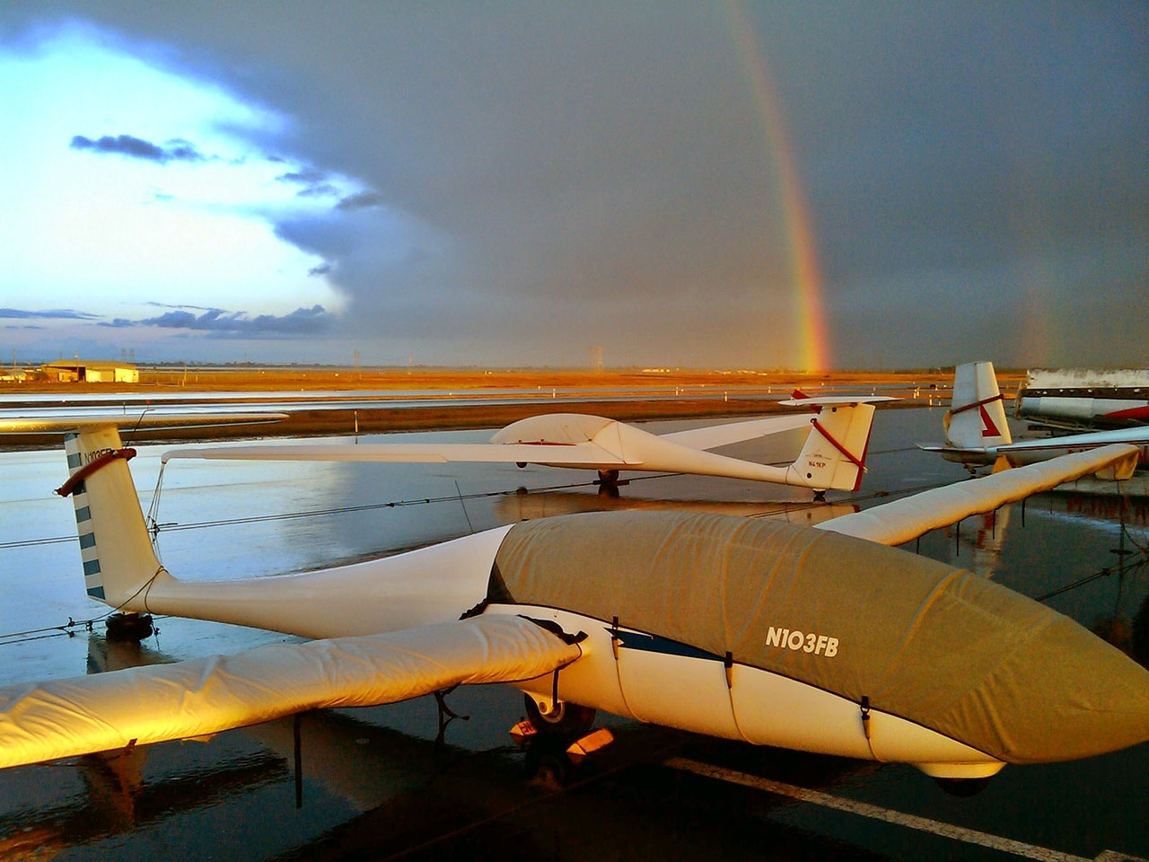
Northern California Soaring Association
Certificate of Achievement 2015
TOTAL CROSS-COUNTRY DISTANCE AWARD
STANDARD CLASS
Marianne Guerin 4226 km

Slide 42
Northern California Soaring Association
Certificate of Achievement 2015
TOTAL CROSS-COUNTRY DISTANCE AWARD
ADVANCED CLASS
Ramy Yanetz 36592 km

Slide 43
TOTAL NUMBER OF FLIGHTS 2015
Dan Colton 28
Marton KS 39
Willy Snow 40
Ace Lewis 45
Todd Denman 50
Tom Anklam 54
Bob Semans 73
Ramy Yanetz 73
Matthew Gast 112
Larry Suter 285

Slide 44
TOTAL GLIDER HOURS- 2015
Ace Lewis 11.8
Todd Denman 30
Matthew Gast 32.8
Marton KS 34
Dan Colton 41.5
Tom Anklam 46
Willy Snow 62

Slide 45
TOTAL GLIDER HOURS- 2015
Mike Mayo 89 (0.5 week)
Marianne Guerin 97 (0.6 week)
Larry Suter 185 (1.1 week)
Buzz Graves 198+instruction
              (~1.5 week)
Ramy Yanetz 412 (2.5 weeks)

Slide 46
Landouts
Willy- 1x Susanville, 2x Stead, 1x Nervino, 1x Carson, 1x Panoche
Marianne- A few too many, at least according to my bank account
Ramy- Only one true field landout: Mapes Ranch near Tracy. Additional 4 unplanned landouts in airports.

Slide 47
LONGEST FLIGHT (KM) – FROM BYRON 2015 OLC
Larry Suter- 4/11/15 - 173km
Ramy Yanetz- 4/10/15 - 608 km

Slide 48
LONGEST FLIGHT USING CLUB SHIPS
Brian Roach 68km 9/5/15 Truckee
Marton KS 68.5 km 6/2/15 ASI
Tom Anklam 91km 4/6/15 Byron
Maja Djurisic 110km 6/15/15 Minden
Larry Suter/Gary Hethcoat 111 km, 9/12/15 TRK
Andrew Chant 189 km 6/8/15 ASI
Dan Colton 219 km 7/24/2015 TRK

Slide 49
LONGEST DISTANCE (KM) – ANYWHERE 2015 OLC
Marton KS 8/23/15 71km ASI
Tom A 4/6/15 91km Byron
Maja Djurisic 6/15/15 110km Minden
Brian Roach 154km 7/18/15 ASI
Van Henson 8/23/15 180km
Andrew Chant 189 km 6/8/15 ASI
Dan Colton 219 km 7/24/2015 Truckee
Walter Friedrich 5/1/15 245km
Marianne Guerin 7/19/15 295 ASI

Slide 50
LONGEST DISTANCE (KM) – ANYWHERE 2015 OLC
Willy Snow 350km from Truckee 7/24/15
Morteza Ansari 6/5/15 381km
Larry 8/10/15 458km ASI
Jim Alton 8/10/15 512km KTRK
Shannon Madsen 6/13/15 552km KTRK
Mike Mayo 9/11/2015 575km KTRK
Buzz Graves 8/9/15 669km Truckee
Ramy 4/5/15 - Minden - 1792km

Slide 51
Northern California Soaring Association
Certificate of Achievement 2015
LONGEST DISTANCE FLIGHT
STANDARD CLASS
Willy Snow 350 km

Slide 52
Northern California Soaring Association
Certificate of Achievement 2015
LONGEST DISTANCE FLIGHT
ADVANCED CLASS
Ramy Yanetz 1792 km

Slide 53
HIGHEST ALTITUDE ACHIEVED FROM BYRON:
Tom Anklam 10,300 4/4/15
Marton KS 10,700 3/15/15
Ramy Yantez 17,999 3/15/15

Slide 54
HIGHEST ALTITUDE ACHIEVED ANYWHERE:
Tom Anklam 14,000 ASI 8/21/15
Larry Suter 17,999 Sierra, several
Ramy Yantez 17,999 Sierra and Byron

Slide 55
FASTEST AVERAGE X-C SPEED ANYWHERE (OLC Flight >100km)
km/hr km
Van Henson 61 181 8/23/15
Maja Djurisic 63 110 6/15/15
Andrew Chant 68 189 6/8/15
Dan Colton 79 196 8/22/15
Morteza Ansari 86 382 6/5/15
Walter Friedrich 97 154 7/16/15
Marianne Guerin 97 213 8/9/15

Slide 56
FASTEST AVERAGE X-C SPEED ANYWHERE (OLC Flight >100km)
km/hr km
Buzz Graves 107 107 8/9/15
Larry Suter 109 458 8/10/15
Shannon Madsen 117 553 6/13/15
Jim Alton 119 461 9/11/15
Michael Mayo 130 575 9/11/15
William Snow 145 138 9/12/15
Ramy Yanetz 183 1792 4/5/15

Slide 57
Northern California Soaring Association
Certificate of Achievement 2015
FASTEST OLC SPEED FOR A FLIGHT > 100KM
STANDARD CLASS
Willy Snow 145 kph over 138 km

Slide 58
Northern California Soaring Association
Certificate of Achievement 2015
FASTEST OLC SPEED FOR A FLIGHT > 100KM
ADVANCED CLASS
Ramy Yanetz: 183 kph over 1792 km

Slide 59
Member Achievements and Milestones in 2015
Numbers
Awards and Recognition

Slide 60
NCSA Cross Country Perpetual Trophy
Rules:
Only OLC flights where club is NCSA
Pasco’s Sawyer Award’s rules:
-Can only win twice
-Region 11 flights only
-Score based on OLC “points” X (Pilot Factor)
-The Pilot Factor helps level the field for newer pilots and encourage budding XC pilots
  eg- Ramy, Buzz, Mike S PF=0.7
  Mike Mayo, Larry PF=1.0
  Terence, Marianne PF=1.5
  Van, Maja PF=3.0

Slide 61
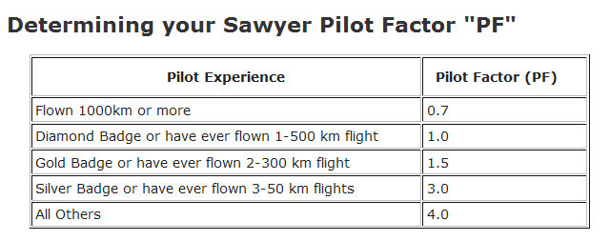
The Pilot Factor gives newer XC pilots a real chance (given that Ramy’s already won it twice)
  eg- Ramy, Buzz, Mike S PF=0.7
  Mike Mayo, Larry PF=1.0
  Terence, Marianne PF=1.5
  Van, Maja PF=3.0

Slide 62
This is the order in “km”
Pilot km
Ramy Yanetz (US) 36592
Buzz Graves (US) 13419
Michael Mayo (US) 8048
Larry Suter (US) 7036
Jim Alton (US) 5975
Marianne Guerin (US) 4226
William Snow (US) 3434
Shannon Madsen (US) 2851
Van Henson (US) 1864
Matthew Gast (US) 1468
Dan Colton (US) 1466
Morteza Ansari (CA) 1070
Marton KS (US) 811
Brian Roach (US) 792
Walter Friedrich (US) 754
Thomas Anklam (US) 588

Slide 63
This is the order in “points”
Pilot Points PF
Ramy Yanetz (US) 35470 0.7
Buzz Graves (US) 12502 0.7
Michael Mayo (US) 8234 1
Larry Suter (US) 7689 1
Jim Alton (US) 5860 1
Marianne Guerin (US) 4434 1.5
William Snow (US) 3752 3
Shannon Madsen (US) 2850 1
Van Henson (US) 2179 3
Matthew Gast (US) 1915 4
Dan Colton (US) 1829 4
Morteza Ansari (CA) 1085 1
Marton KS (US) 1084 4
Brian Roach (US) 901 4
Walter Friedrich (US) 761 1.5
Thomas Anklam (US) 743 4

Slide 64
This is the order in “Sawyer Score”
Pilot Sawyer Score (points*PF)
Ramy Yanetz (US) 24829
William Snow (US) 11257
Buzz Graves (US) 8751
Michael Mayo (US) 8234
Larry Suter (US) 7689
Matthew Gast (US) 7659
Dan Colton (US) 7318
Marianne Guerin (US) 6651
Van Henson (US) 6538
Jim Alton (US) 5860
Marton KS(US) 4337
Brian Roach (US) 3603
Thomas Anklam (US) 2972
Shannon Madsen (US) 2850
Andrew Chant (CA) 2021

Slide 65
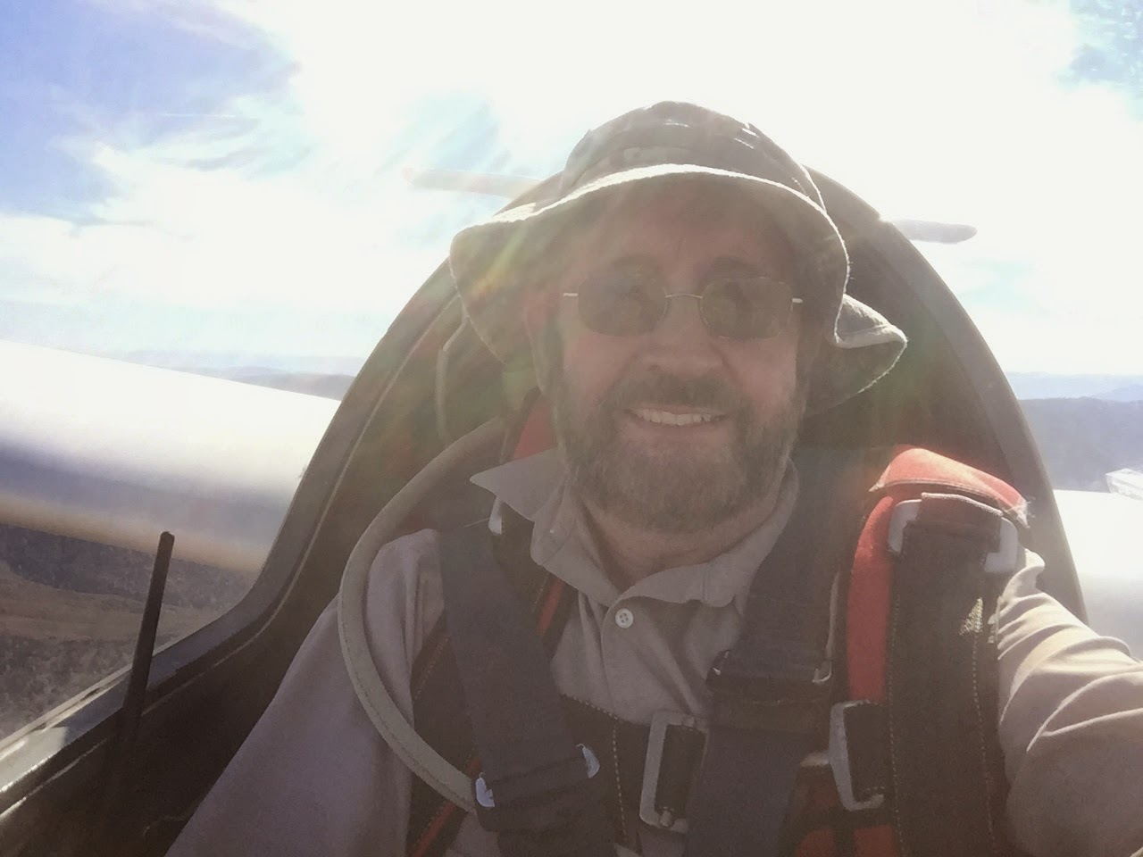
This is the order in “Sawyer Score”
Congratulations, Willy!!!
Pilot Sawyer Score (points*mult)
Ramy Yanetz (US) 24829
William Snow (US) 11257
Buzz Graves (US) 8751
Michael Mayo (US) 8234
Larry Suter (US) 7689
Matthew Gast (US) 7659
Dan Colton (US) 7318
Marianne Guerin (US) 6651
Van Henson (US) 6538
Jim Alton (US) 5860
Marton KS(US) 4337
Brian Roach (US) 3603
Thomas Anklam (US) 2972
Shannon Madsen (US) 2850
Andrew Chant (CA) 2021
Pilot | Sawyer Score (points*mult)
Ramy Yanetz (US) | 24829
William Snow (US) | 11257
Buzz Graves (US) | 8751
Michael Mayo (US) | 8234
Larry Suter (US) | 7689
Matthew Gast (US) | 7659
Dan Colton (US) | 7318
Marianne Guerin (US) | 6651
Van Henson (US) | 6538
Jim Alton (US) | 5860
Marton Kun-Szabo (US) | 4337
Brian Roach (US) | 3603
Thomas Anklam (US) | 2972
Shannon Madsen (US) | 2850
Andrew Chant (CA) | 2021

Slide 66
So who’s going to win in ’16?
Pilot 2015 km 2016 PF
Matthew Gast (US) 1468 4
Marton KS(US) 811 4
Brian Roach (US) 792 4
Thomas Anklam (US) 588 4
Dan Colton (US) 1466 3
Van Henson (US) 1864 3
William Snow (US) 3434 1.5
Marianne Guerin (US) 4226 1.5
Walter Friedrich (US) 754 1.5
Michael Mayo (US) 8048 1
Larry Suter (US) 7036 1
Jim Alton (US) 5975 1
Shannon Madsen (US) 2851 1
Morteza Ansari (CA) 1070 1
Buzz Graves (US) 13419 0.7

Slide 67
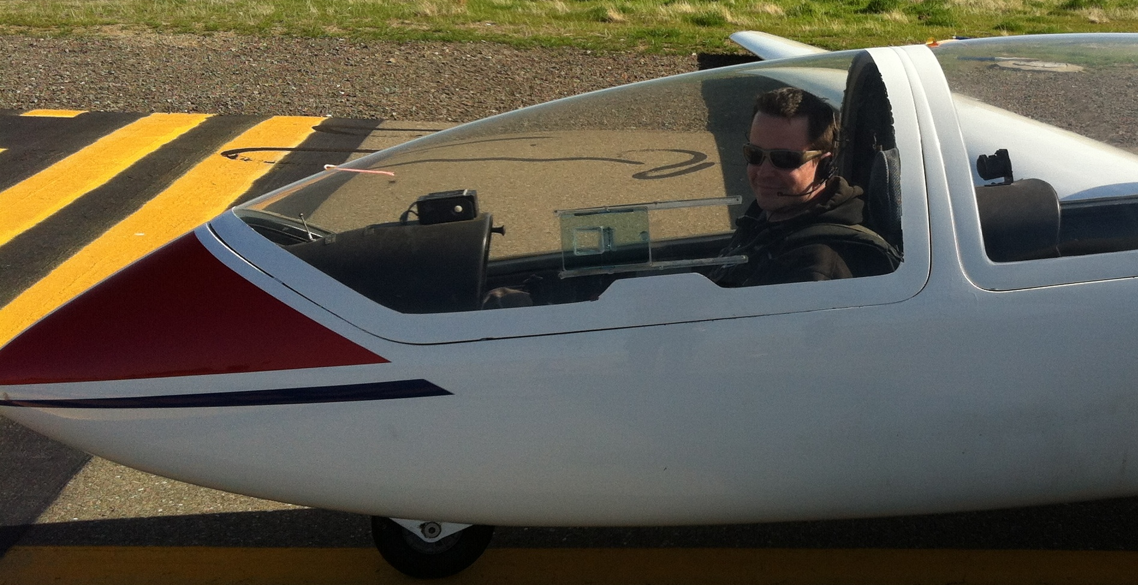
The Coveted 1-26 Trophy recognizing the longest 1-26 OLC flight in 2015
Marton Kun-Szabo – 63 km Air Sailing Thermal Camp 6/2/15

Slide 68
MOST IMPROVED PILOT 2015:
Had his 1st two 300 km OLC flights ever
Had a flight >100 km averaging 145 km/hr
Beat Buzz, Mike Mayo (and me) for the Perpetual Trophy
And did it all w/o the winglets of his dreams

Slide 69
MOST IMPROVED PILOT 2015:
Willy Snow

Slide 70
Northern California Soaring Association
Certificate of Achievement 2015
MOST IMPROVED PILOT
Willy Snow

Slide 71
2015 NCSA Tow Pilots
Rolf Peterson- Chief Tow Pilot
Dave Magaw- 159
Paul MacDonald- 153
John Scott- 271
Shamim Mohamed
Rick Robbins
Dale Roberts
Steve Adams
Ed Ott
Larry Suter- 77
Thank you, Towpilots!!!!!!!

Slide 72
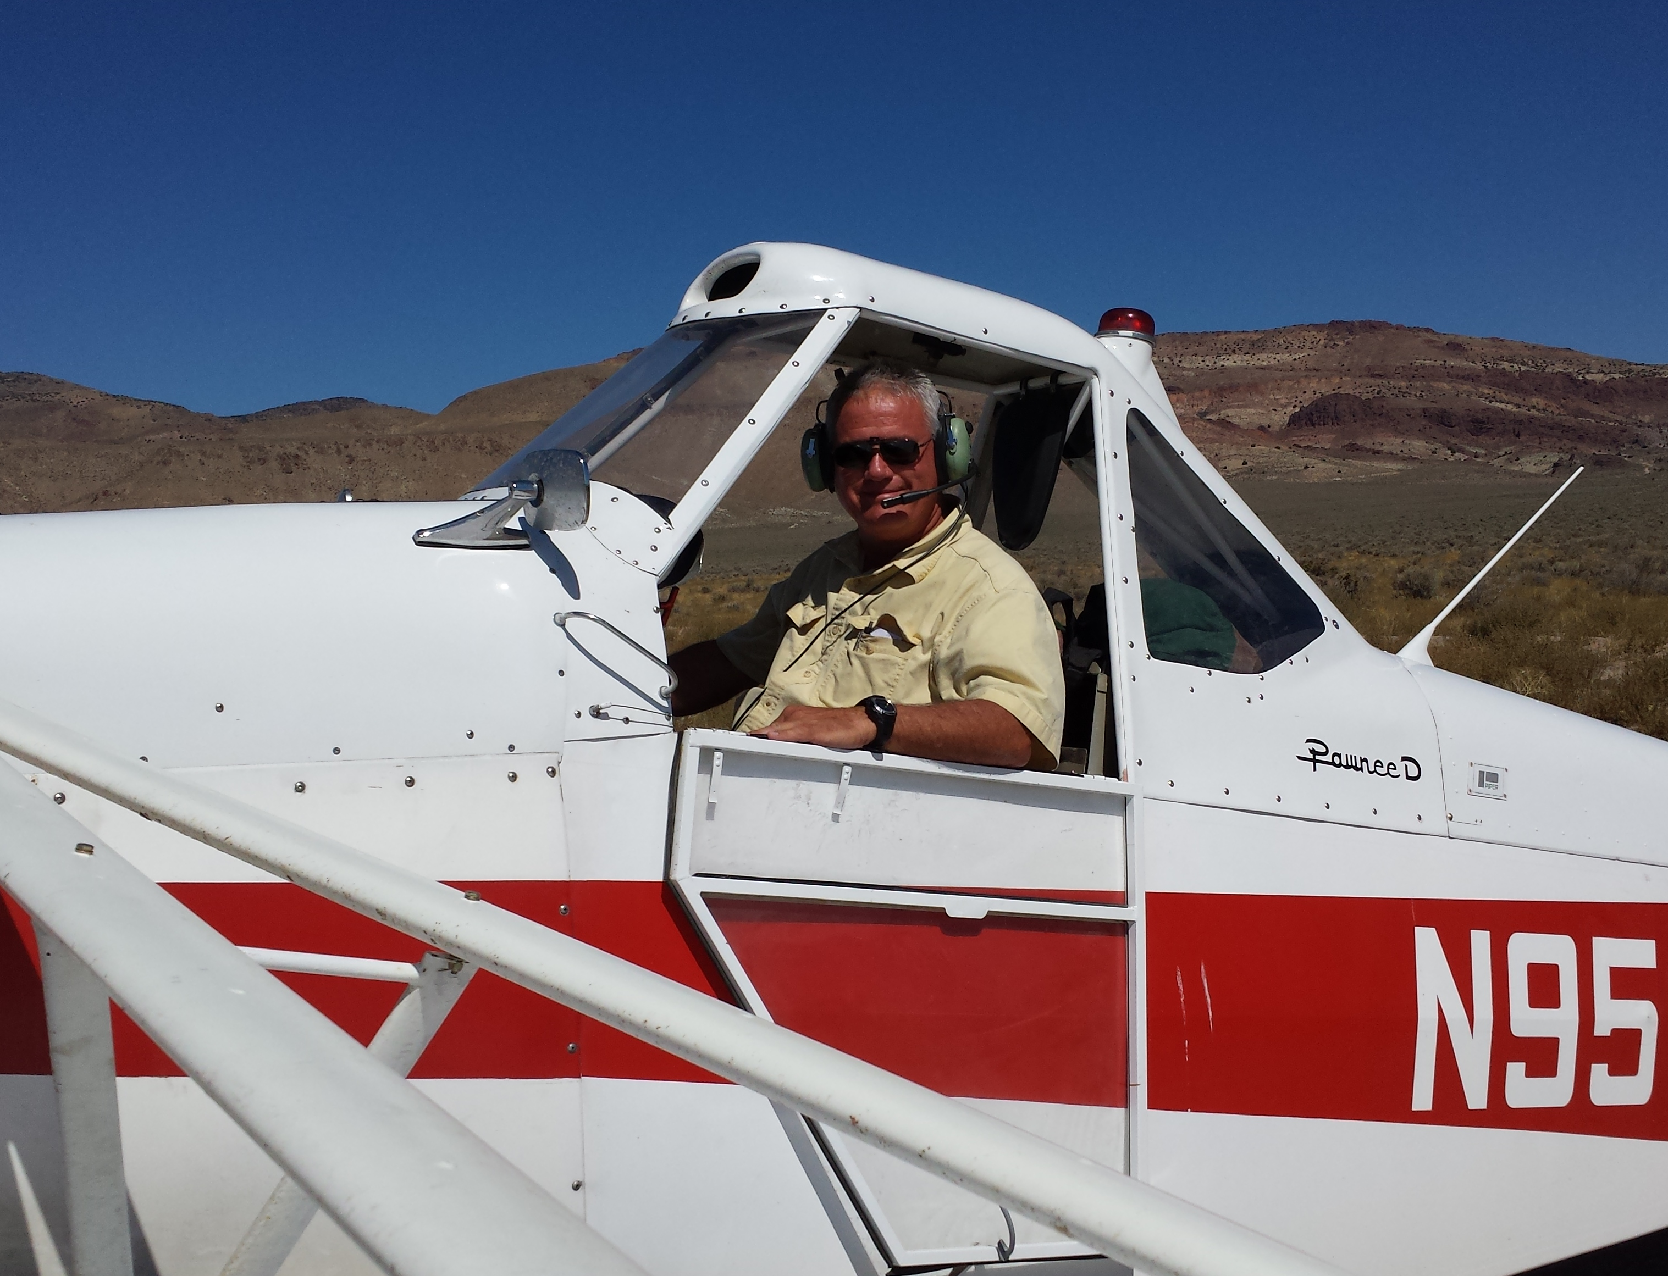
Tow Pilot of the Year 2015
John Scott
271 NCSA tows
216 ASI tows
Regularly available to do mid-week tows
Making NCSA Midweek Soaring happen
Made midweek soaring happen at ASI last summer
That was so much fun, I think I’ll do it again!

Slide 73
Northern California Soaring Association
Certificate of Achievement 2015
TOW PILOT OF THE YEAR
John Scott

Slide 74
NCSA SPARK PLUG OF THE YEAR 2015
John Jewell
John does innumerable services for the club
Maintains clubhouse
Rebuilt the deck
Services the golf carts
Maintains the tie downs
Does things like paint and label ballast
Resupplies water
.
.
.
Thank you, John!

Slide 75
Northern California Soaring Association
Certificate of Achievement 2015
NCSA SPARKPLUG
John Jewell

Slide 76
2015 Instructors:
  Mike Schneider- Chief Instructor
  Buzz Graves
  John Randazzo
  John Boyce
  Terence Wilson
  Matthew Gast
  Larry Suter
  Mike Voie (on leave)

Slide 77
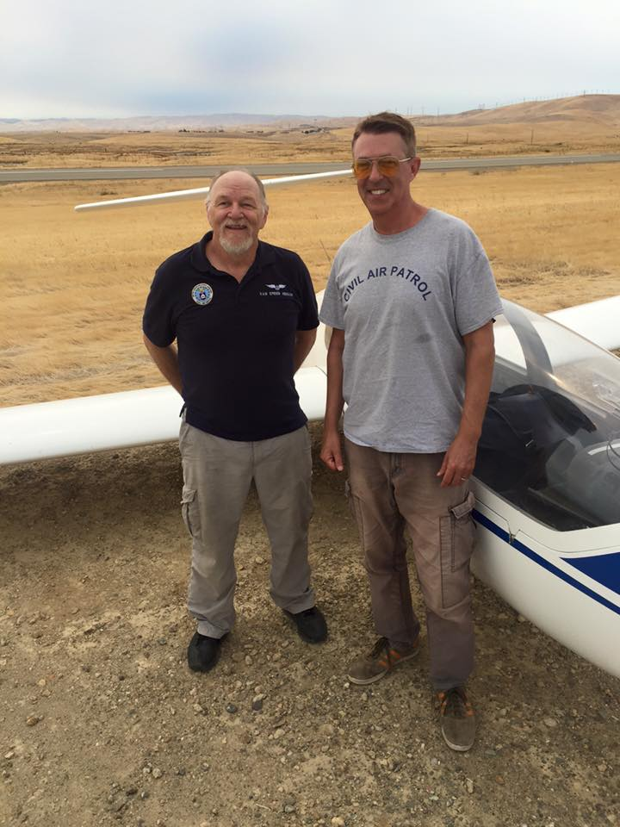
Instructor of the Year (Yet Again)
Terence Wilson
Continues to be the “finisher” for our club’s students
Prepared Matthew for CFI-G
Preparing several commercial pilots
CAP Check Pilot for qualifying CAP O-ride pilots

Slide 78
Northern California Soaring Association
Certificate of Achievement 2015
INSTRUCTOR OF THE YEAR
Terence Wilson

Slide 79
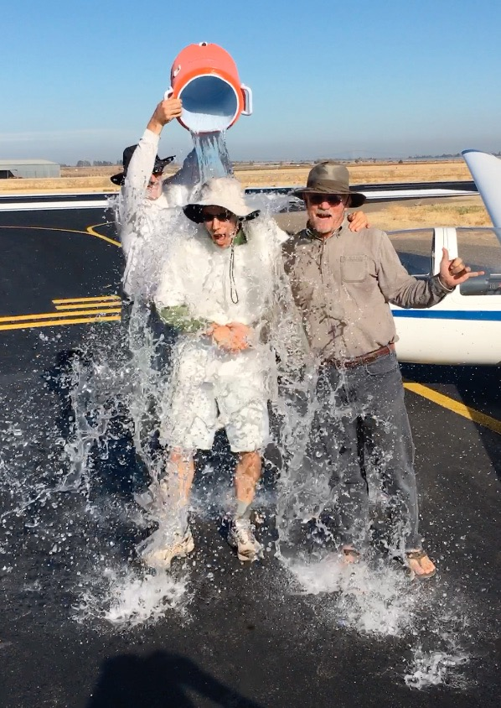
Most Memorable Photo- 2015
Todd’s Solo

Slide 80
Special Presidential Thanks To:
Marianne Guerin for organizing much of Tonight’s Annual Banquet
Quest Richlife for leasing and promptly maintaining 76W
Rolf Peterson for eight years as Chief Towpilot
Paul MacDonald for agreeing to become our new Chief Tow Pilot

Slide 81
Special Presidential Thanks To:
John Randazzo for serving as Treasurer
and for his counciling and wisdom
Monique Weil for her continuing service to the club, her encouragement and wisdom
All who volunteered their time and effort to make NCSA succeed

