Slide 1
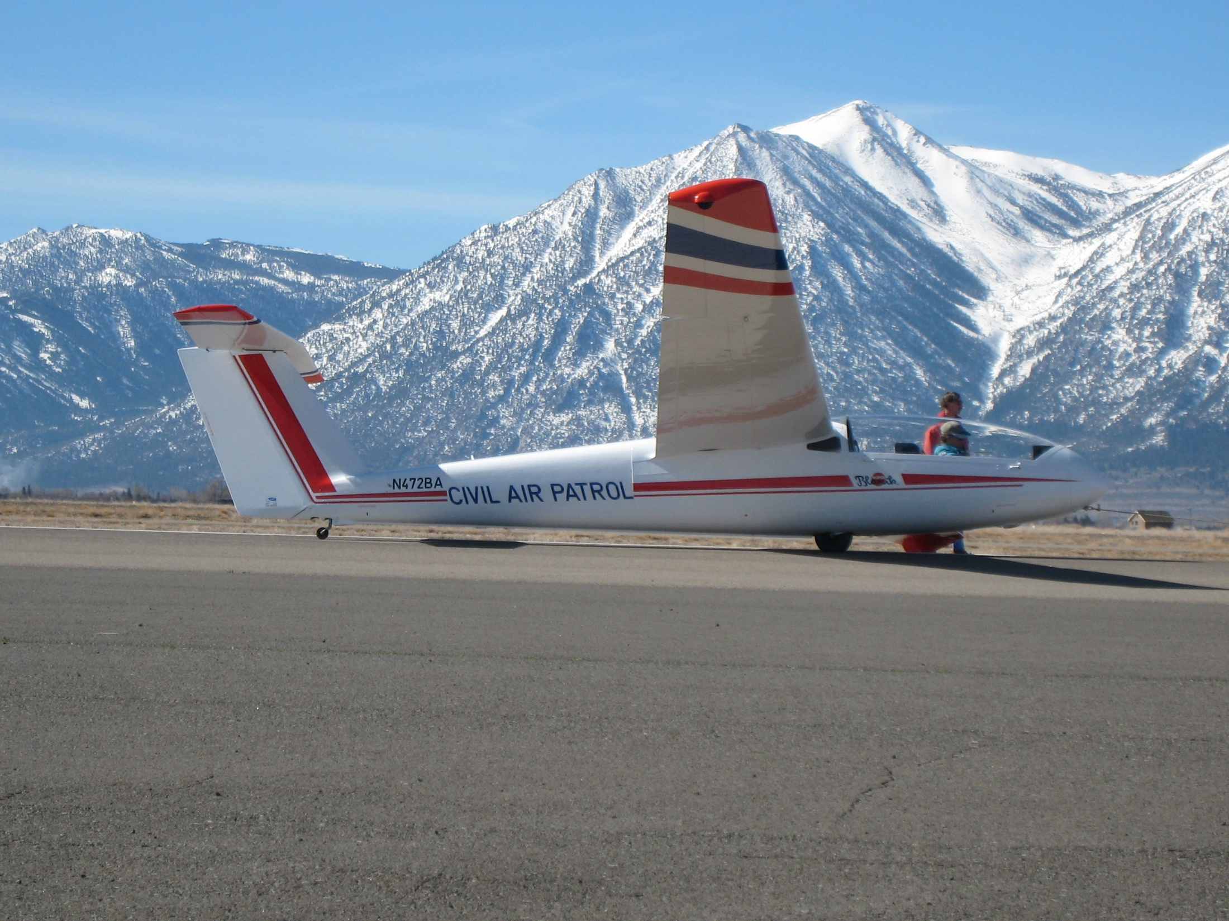
Getting Youth into the Air
The Civil Air Patrol
Glider Program
Bob Semans, CAP Nevada Wing Glider Program

Slide 2
What’s it all about?
Intro to CAP
Scope of Glider Program activities
Benefits to cadets, glider pilots and others
What it takes to join & qualify

Slide 3
What is the Civil Air Patrol?
US Air Force Auxiliary
CAP is chartered by Congress
Non-Profit Corporation
Tax Exempt

Slide 4
CAP Geographic Organization

Slide 5
CAP Missions
Emergency Services
Aerospace Education
Cadet Programs

Slide 6
CAP Glider Program - History
Test Program in Georgia
1996 SSA & CAP reached agreement to jointly support a CAP Glider Program
Orientation Flight Syllabus expanded to include gliders
Glider Pilots recruited, primarily from clubs
CAP glider fleet built up
Glider fleet now stands at ~ 42 --- Blanik L-23s, SGS 2-33s, ASK-21, ++

Slide 7
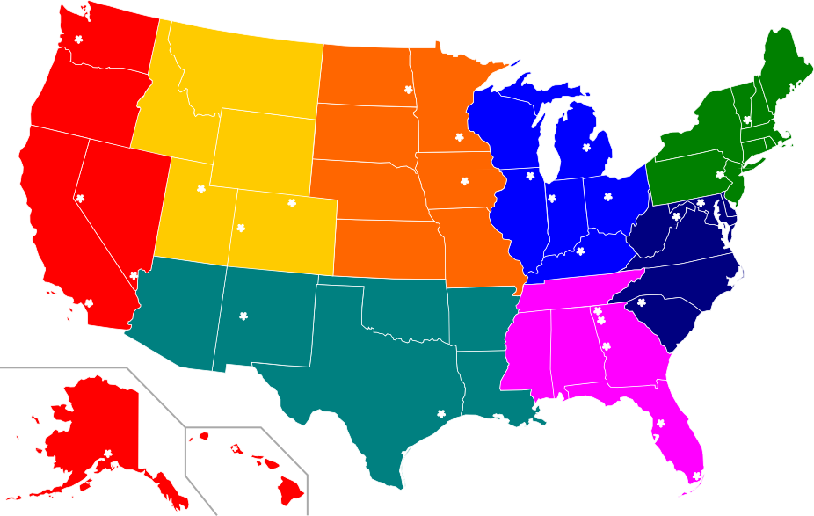
CAP Glider Fleet Locations

Slide 8
CAP Glider Program Activities
Cadet glider orientation flights
5 funded flights per cadet.
Flown by CFIGs OR Private Glider Pilots with 100 flights as PIC
Instruction – by volunteer instructors
Primary instruction for cadets
Primary & transition instruction for Senior Members
Check flights & proficiency flying

Slide 9
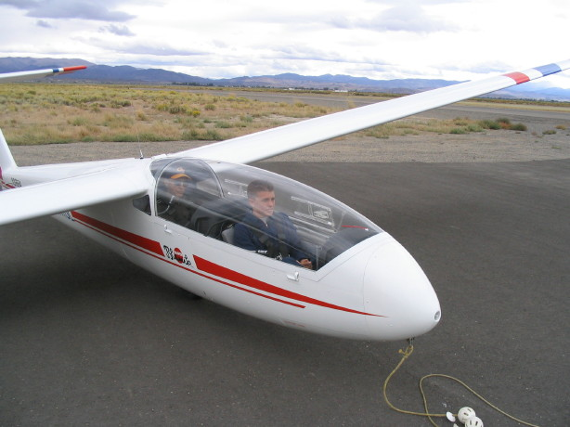
Glider Orientation Flights Syllabus 1- 5
Intro: 3 axis control, coordinated turns, pattern
Hands-off flight, turns at various speeds
Slow flight, stalls, steep turns
Instrument use
Soaring techniques

Slide 10
Cadet Glider Flight Instruction
National Flight Academy – Gliders
~ 100 cadets attended in 2011 at 4 sites
Glider encampments
~10 to 20 cadets per encampment
Local on-going instruction programs

Slide 11
National Glider Flight Academy 2011 Locations

Slide 12
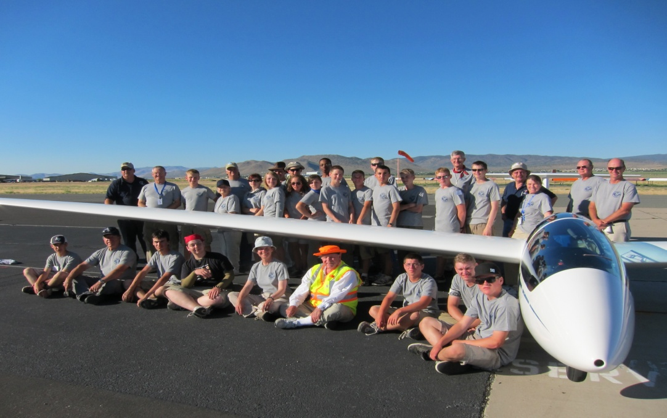
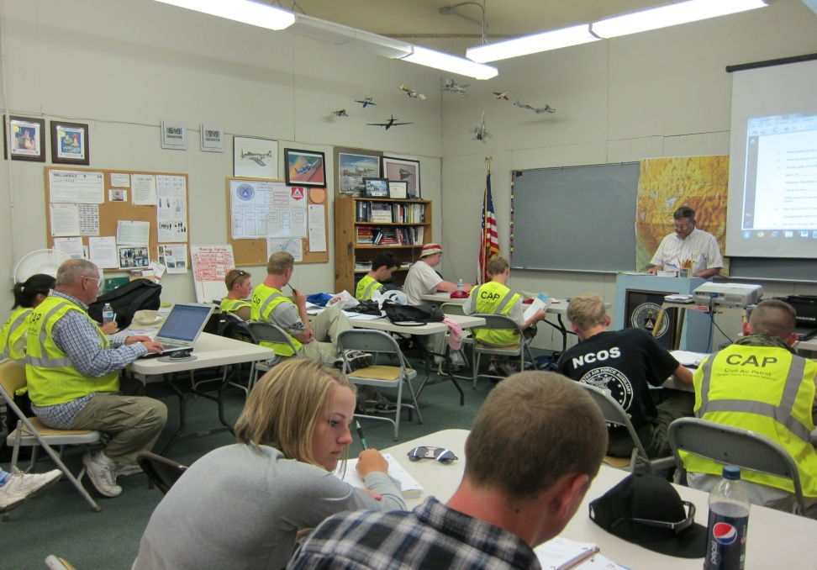
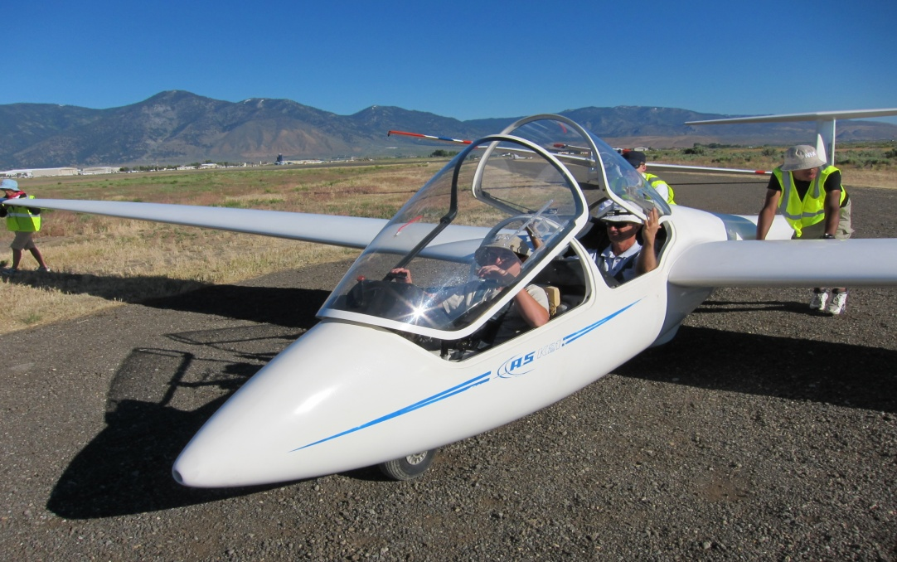
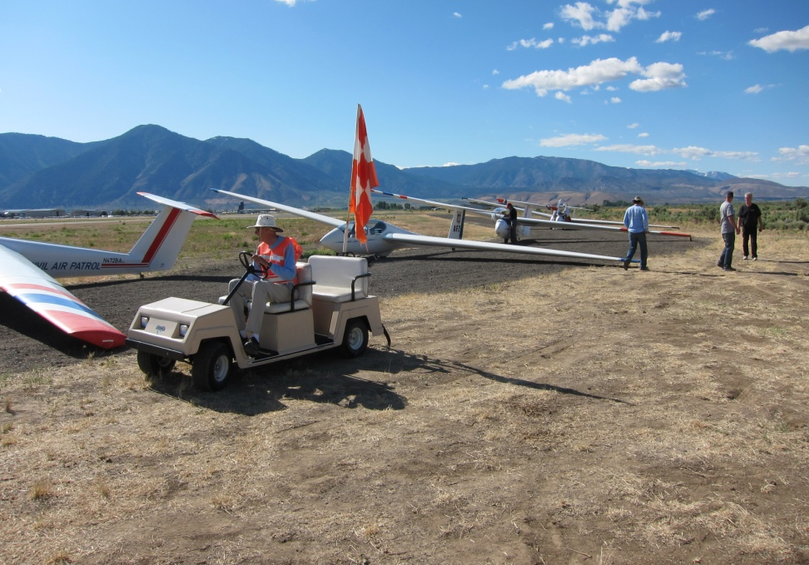
NFA-G Minden 2011

Slide 13
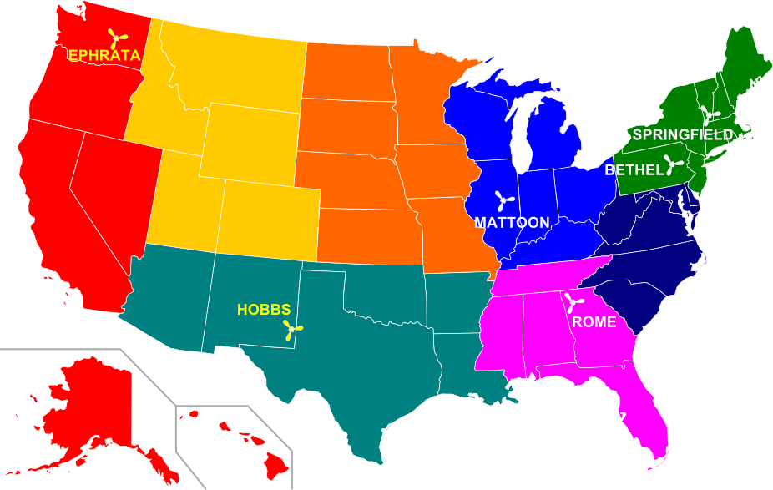
National Glider Flight Academy 2012 Locations + Encampments

Slide 14
On-going Cadet Instruction by local host Squadrons
Several across the US
Examples in Pacific Region:
California Wing at Los Alamitos
Nevada Wing at Jean & Minden

Slide 15
Why might a glider pilot be interested?
It’s FUN

Slide 16
Why might a glider pilot be interested?
It’s FUN
“Psychic income”

Slide 17
Why might a glider pilot be interested?
It’s FUN
“Psychic income”
Introduce youth to aviation & soaring

Slide 18
Why might a glider pilot be interested?
It’s FUN
“Psychic income”
Introduce youth to aviation & soaring
Increased glider activity & awareness

Slide 19
Why might a glider pilot be interested?
It’s FUN
“Psychic income”
Introduce youth to aviation & soaring
Increased glider activity & awareness
Funded orientation flights for cadets

Slide 20
Why might a glider pilot be interested?
It’s FUN
“Psychic income”
Introduce youth to aviation & soaring
Increased glider activity & awareness
Funded orientation flights for cadets
Flying and other expenses – deductible

Slide 21
Why might a glider pilot be interested?
It’s FUN
“Psychic income”
Introduce youth to aviation & soaring
Increased glider activity & awareness
Funded orientation flights for cadets
Flying and other expenses – deductible
CAP Gliders available for use at lower rate

Slide 22
Why might a glider pilot be interested?
It’s FUN!
“Psychic income”
Introduce youth to aviation & soaring
Increased glider activity & awareness
Funded orientation flights for cadets
Flying and other expenses – deductible
CAP Gliders available for use at low rate
Training funds; a paid “Flying Opportunity”

Slide 23
How to Join the Program and Qualify as a CAP Glider Pilot -
CAP Membership
Training – Mostly on-line courses:
CAP History & Organization
Cadet Protection Policy & Practices
Equal Opportunity Policy
Safety Topics
Flight Regulations
Check Flight

Slide 24
Check Flight
Required
ONCE in each aircraft type (Initial)
Annually in each aircraft group (Gliders)
Pre-requisites for check flight:
On-line exam on Operations Regs (40 questions)
Answer Aircraft Questionnaire for EACH aircraft in which you are qualified

Slide 25
Aircraft Questionnaire
Speeds (best glide, min sink, stall, etc.)
Rope break actions
Take-off and landing check lists
Spin recovery
Weight and balance

Slide 26
Recap
Intro to CAP
Scope of Glider Program activities
Benefits to cadets, glider pilots and others
What it takes to join & qualify

Slide 27
Recap
Intro to CAP
Scope of Glider Program activities
Benefits to cadets, glider pilots and others
What it takes to join & qualify
There are more than 26,000 Cadets in CAP - A few may be waiting for you!

Slide 28
Bob Semans semans@charter.net
NV 775-267-4157 CA 650-358-8898
Douglas County Composite Squadron NV-067
Minden-Tahoe Airport (MEV)

